Slide 1
Econometrics 441/871
Lecture 1
Overview of course,
difference equations and their solutions

Slide 2
Plan
Admin and Course Intro
Intro to time series data
Difference Equations and their solutions
Discussion and Definitions
Some practice and examples
Goal of the lecture:
To derive the conditions/rule under which a difference equation has a well-defined solution
This will become the conditions under which a univariate stochastic time series process is stationary

Slide 3
The Team
Part 1: Time Series Econometrics
6/7 topics
Gideon du Rand (gideondurand@sun.ac.za)
Rm 503 C.G.W Schumann Building
Part 2: Cross Section Econometrics
6 weeks
Cobus Burger (cobusburger@sun.ac.za)
Rm 608 C.G.W. Schumann Building

Slide 4
Assessment
 | Dates | Weight in Final Mark
Time Series Assessment mid semester test | 15 April 2024 | 25%
Time Series Research Project | 29 April 2024 | 20%
Cross Section Assessment exam | Date to be announced | 25%
Cross Section Research Project | 24 June 2024 | 20%
Graded Exercises | Throughout module | 10%
Notes:
50/50, not a solo endeavour to impress me. It is a learning experience where I expect to assist at sort of “mini” thesis level.

Slide 5
Assessment details
Read the course outline carefully
Passing requirements:
You need a final course mark of 50% to pass the course
You must obtain at least 40% in the assessment on each section

Slide 6
Assessment details
Departmental rules:
Time Series Assessment
The semester test on Time Series is compulsory
Absence only excused with a valid medical certificate
Submitted within 48 hours to Gideon
If you are medically excused from or obtain <40% in the Time Series semester test
You must write the Time Series sick test (on the same day as the Cross Section exam)
You must obtain at least 40% in the Time Series sick test to pass the course
If taken as second opportunity, test mark capped at 50%
If you obtain 40-49% in the Time Series semester test, you may write Time Series sick test
The Time Series sick test mark also capped at 50%
The sick test is the final opportunity to pass the Time Series component of the course

Slide 7
Assessment details
Departmental rules
Cross Section Assessment
The exam on Cross Section is compulsory
Absence only excused with a valid medical certificate
Submitted within 48 hours to Carina
If you obtain <40% in the Cross Section exam, you fail the course
If you obtain >40% in the Cross Section exam, but your final course mark is <50%
You must write the supplementary exam and perform adequately to obtain a final mark of at least 50% to pass the course. Note that your final course mark will be capped at 50%.
If medically excused from exam,
there is no cap on sick exam
The sick exam is the final opportunity to pass the Cross Section component of the course

Slide 8
Assessment details
Rules on medical excuses from assessment
If you submit a valid medical certificate that excuses you from assessment on a given day, you cannot write any assessment on that day
For this course this implies the following: If you are medically excused or obtain less than 40% on the Time Series test,
you must write the sick test and the exam on the same day to be eligible to pass the course
A(nother) medical excuse for the exam and sick test will imply an immediate incomplete on the course

Slide 9
Time Series Research Project
Replication and sensitivity analysis of an extant time series study
Find a published time series study to replicate
From a top 500 journal on https://ideas.repec.org/top/old/0702/top.journals.simple.html
You need to be able to find the same data used
Post a proposal on SUNLearn for my approval and assistance
The focus is on technique, understanding and exposition
Not a full, novel research proposition with extensive literature review

Slide 10
Resources
Textbooks:
Enders, Walter (2014) Applied Econometric Time Series, 4th Edition
Hendry, David F. and Nielsen, Bent. (2007). Econometric Modeling: A Likelihood Approach.
Hamilton, James D. (1992) Time Series Analysis.
Course notes:
Kevin Kotze, UCT
https://www.economodel.com/time-series-analysis

Slide 11
Introduction to Time Series Econometrics

Slide 12
Warning | Suggestion
Work is HEAVILY dependent on definitions, terminology
Interrelated, sometimes poorly named
When you encounter a definition, focus on understanding what it means, and learn the name(s) used for it
Definitions must be used precisely
They contain only what they say
They need not conform to “common sense”
Some irregularity in some places:
Time series terminology is sometimes less precise than mathematical definitions – unsettled arguments
A valuable skill is to carefully internalize what each new author means with a specific concept
I’m going to attempt to be careful but won’t manage to be careful enough.
Stop me and get me to be more careful as soon as you get lost/miss something, especially if it is a definition

Slide 13
I don’t know what you don’t know
If I use a term/word you don’t know
Stop me and ask
If I use a symbol you don’t know or can remember the definition of from a previous lecture or even a previous slide
Stop me and ask
If I use a standard statistical concept that you can’t recall at the moment
Stop me and ask
Especially students who did not do honours here

Slide 14
Time Series vs Cross Section
Cross Section
Time Series

Slide 15
Time Series vs Cross Section
Cross Section
Time Series
Std OLS assumptions:
Linearity in parameters
No multi-collinearity
Random Sample from population
Mean-independent regressors E[ε|x]=0
Homoskedasticity
Notes:
I trust all of you have used the break between honours and masters to reflect and reaffirm everything you learned in honours.
Not really, I have to assume a certain level of base knowledge in order to build a lecture, but there is no shame in admitting a lack of a specific item. I am frequently in seminars of specialities that I don’t have, and then I ask when I don’t understand.
No shame in admitting lack of knowledge.
It is a tragedy to not ask a question and lose what you could learn if I happen to be able to clear up the issue because of the question.

Slide 16
Time Series vs Cross Section
Cross Section
Time Series
Std OLS assumptions:
Linearity in parameters
No multi-collinearity
Random Sample from population
Mean-independent regressors E[ε|x]=0
Homoskedasticity
Std Time Series situation:
Linearity in parameters
No multi-collinearity

Slide 17
Time Series vs Cross Section
Cross Section
Time Series
Std OLS assumptions:
Linearity in parameters
No multi-collinearity
Random Sample from population same variables over different individuals with different histories
Mean-independent regressors E[ε|x]=0
Homoskedasticity
Std Time Series situation:
Linearity in parameters
No multi-collinearity
Sample is fundamentally non-random: same variables over time, “same histories”
Notes:
The key feature of time series is the dependence on history. The income path of one person in a cross section will be different from the income path of another. In time series, we have only one history of South African GDP.

Slide 18
Time Series vs Cross Section
Cross Section
Time Series
Std OLS assumptions:
Linearity in parameters
No multi-collinearity
Random Sample from population
Mean-independent regressors E[ε|x]=0
Homoskedasticity
Std Time Series situation:
Linearity in parameters
No multi-collinearity
Sample is fundamentally non-random: same variables over time
Regressors: at best predetermined, mostly simultaneous

Slide 19
Time Series vs Cross Section
Cross Section
Time Series
Std OLS assumptions:
Linearity in parameters
No multi-colinearity
Random Sample from population
Mean-independent regressors E[ε|x]=0
Homoskedasticity
Std Time Series situation:
Linearity in parameters
No multi-collinearity
Sample is fundamentally non-random: same variables over time
Regressors: at best predetermined, mostly simultaneous
Persistence / Auto-correlation is always a concern
But wait… there is more!

Slide 20
Time Series vs Cross Section
Cross Section
Time Series
Std OLS assumptions:
Linearity in parameters
No multi-colinearity
Random Sample from population
Mean-independent regressors E[ε|x]=0
Homoskedasticity
Std Time Series situation:
Linearity in parameters
No multi-collinearity
Sample is non-random: same variables over time
Simplest scenario: drawn from the same distribution over time (stationary and ergodic)
Regressors: predetermined or simultaneous
Auto-correlation is always a concern

Slide 21
Time Series vs Cross Section
Cross Section
Time Series
Std OLS assumptions:
Linearity in parameters
No multi-colinearity
Random Sample from population
Mean-independent regressors E[ε|x]=0
Homoskedasticity
Std Time Series situation:
Linearity in parameters
No multi-collinearity
Sample is non-random: same variables over time
Simplest scenario: drawn from the same distribution over time (stationary and ergodic)
Common case: non-stationary
Regressors: predetermined or simultaneous
Auto-correlation is always a concern

Slide 22
Stylized Facts about economic time series

Slide 23
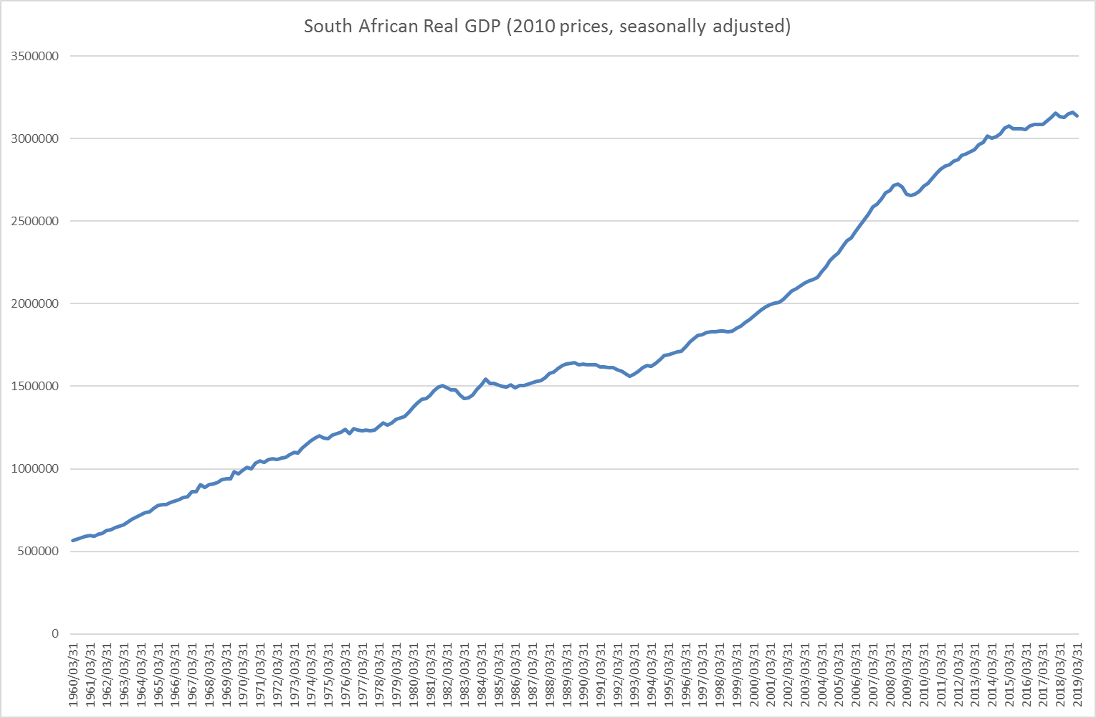
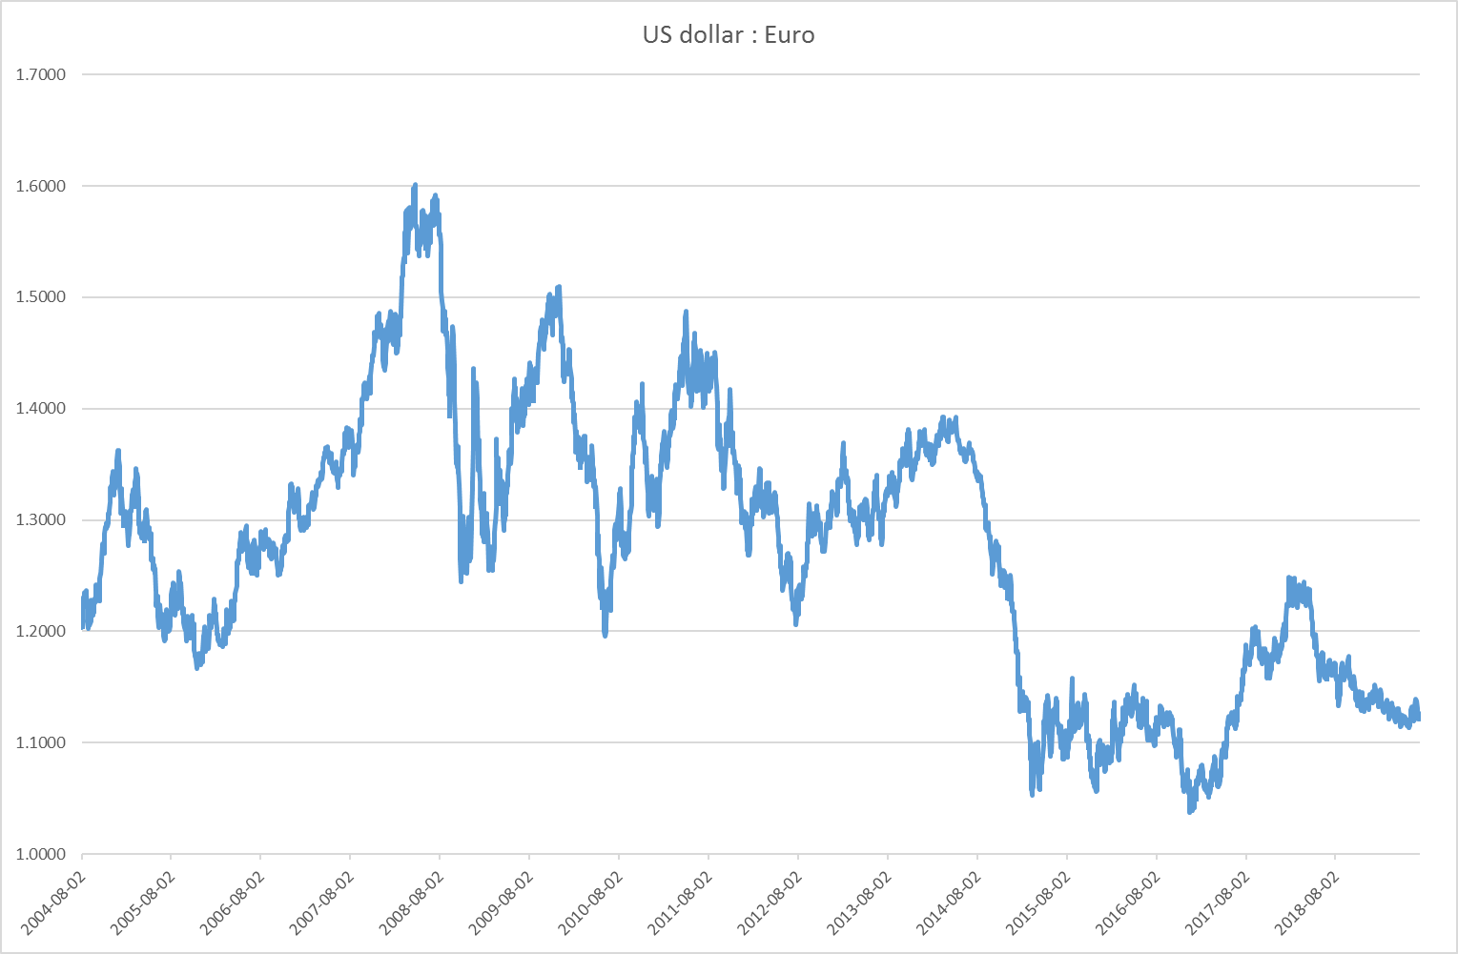
Stylized Facts about economic time series 1. persistence, with or without an apparent trend

Slide 24
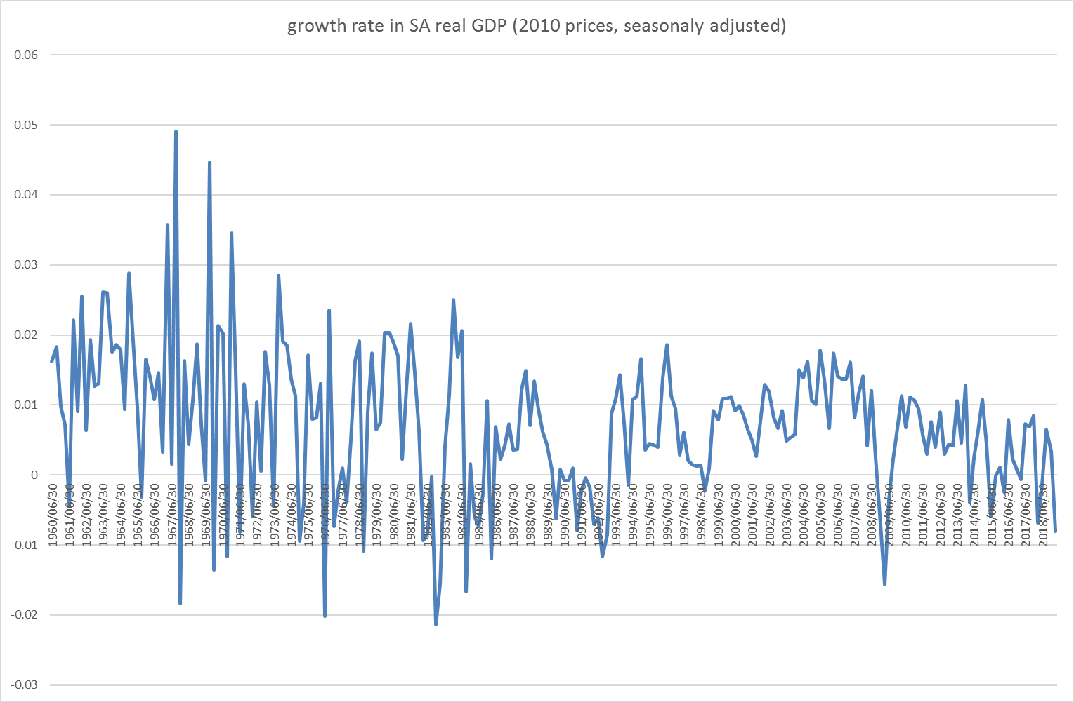
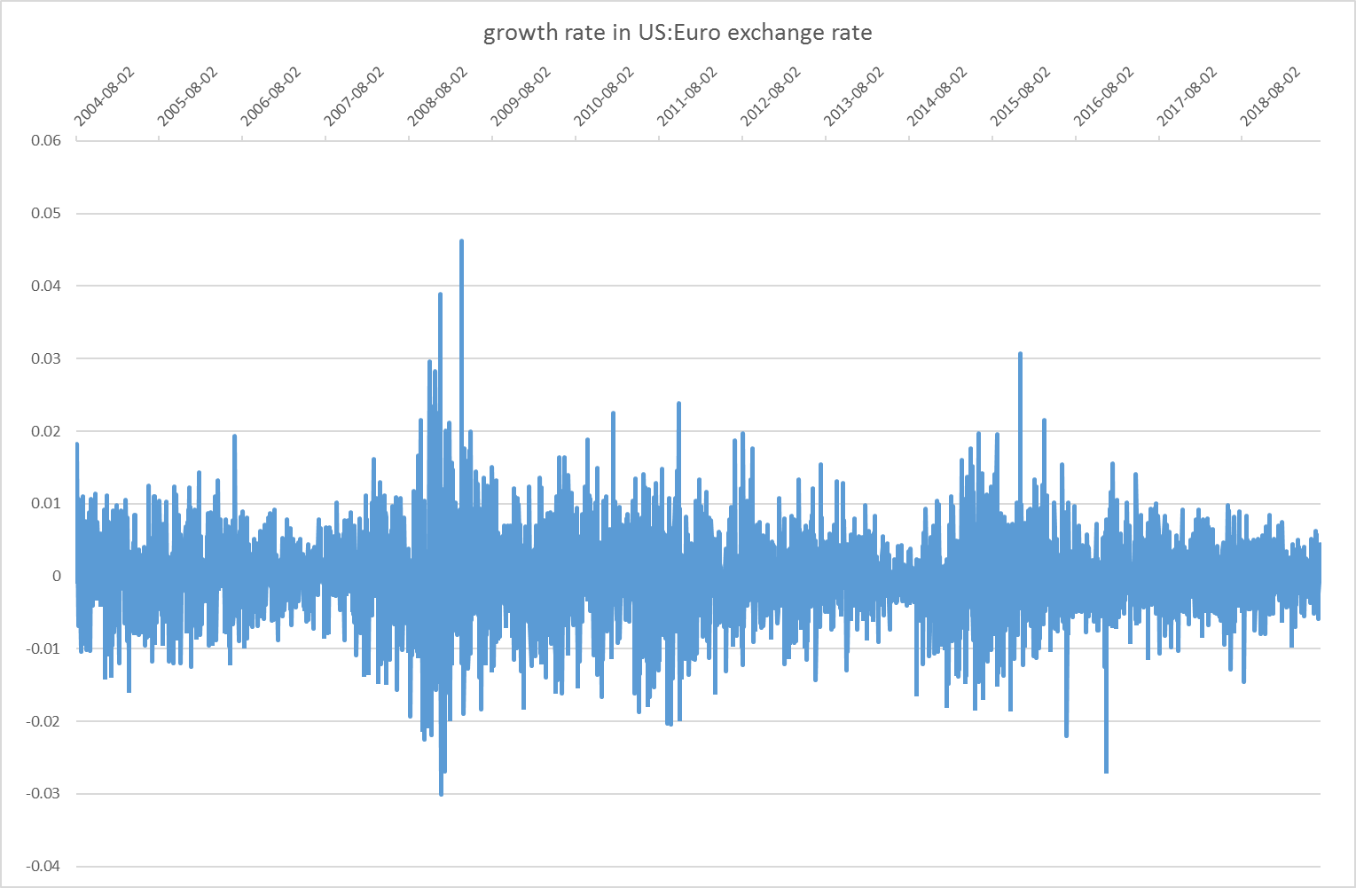
Stylized Facts about economic time series 2. the growth rates of persistent series tends to be far less persistent

Slide 25
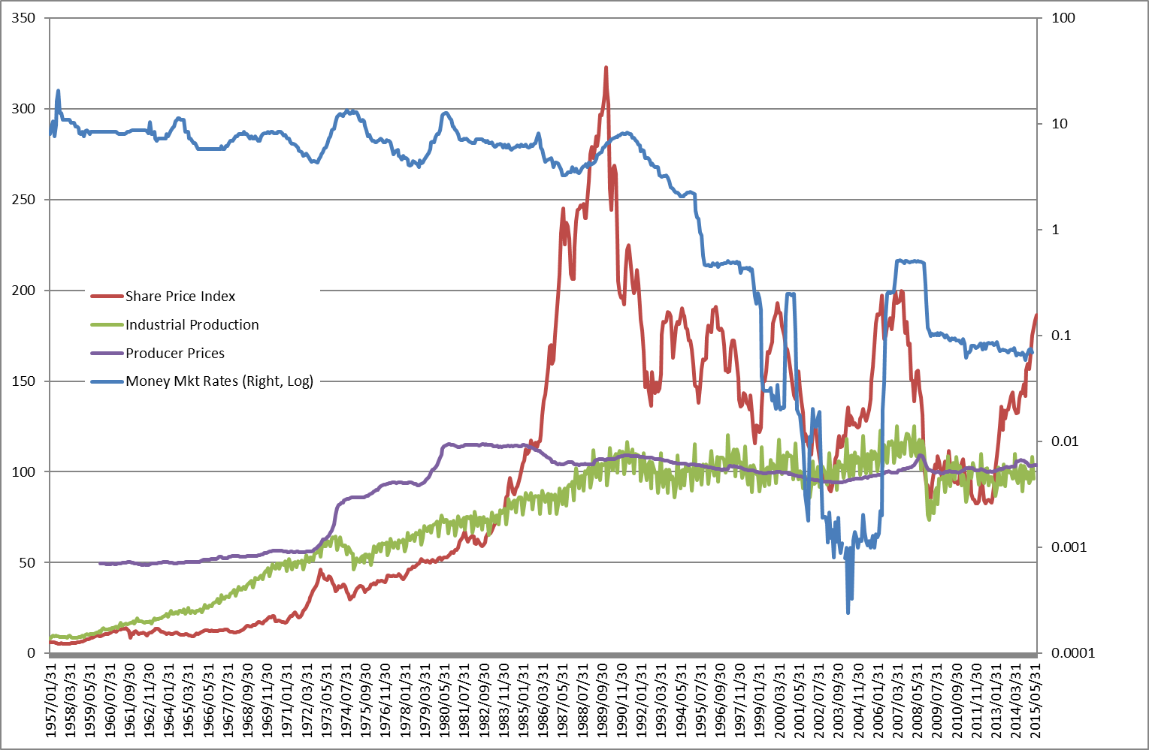
Stylized Facts about economic time series 3. apparently systematic behaviour can change without warning (structural breaks)
Data on Japan, source: fred.stlouisfed.org

Slide 26
Stylized Facts about economic time series 3. apparently systematic behaviour can change without warning (structural breaks)
Data on Japan, source: fred.stlouisfed.org

Slide 27
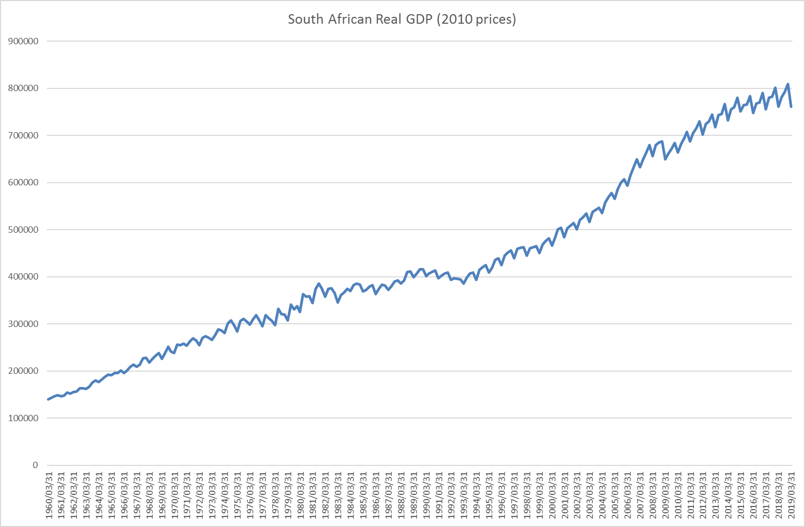
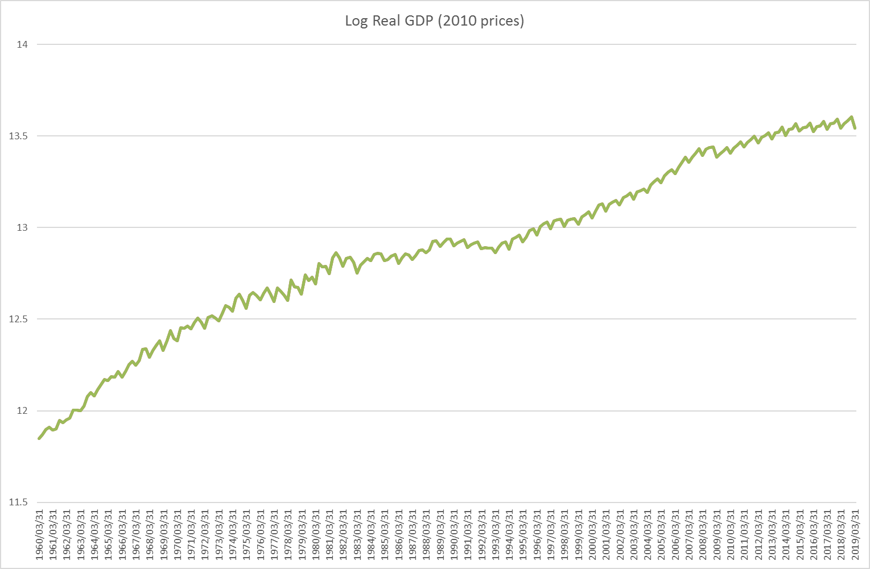
Stylized Facts about economic time series 4. Seasonality is a fundamental feature, but it is not “sinusoidal”, and scaling matters

Slide 28
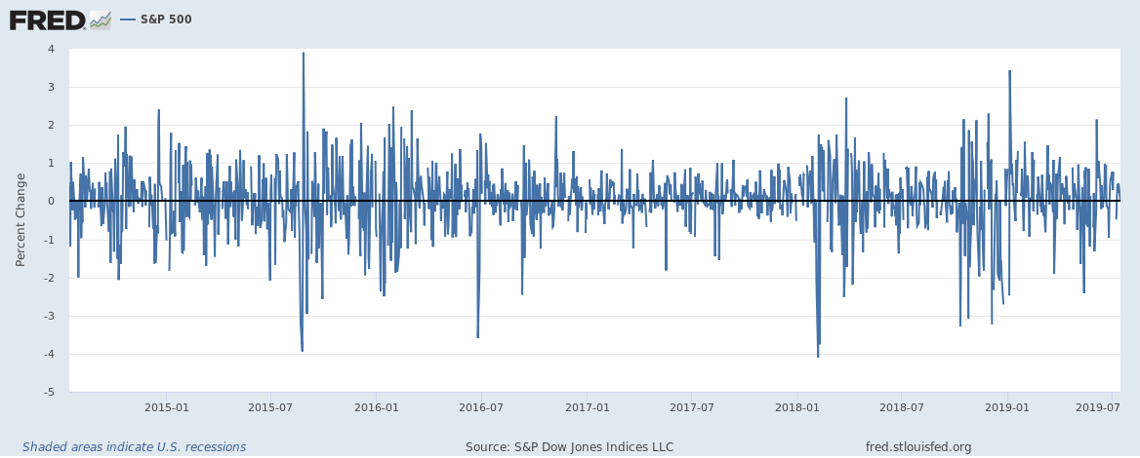
Stylized Facts about economic time series 5. Some series seem to have constant means, but periods of high/low volatility

Slide 29
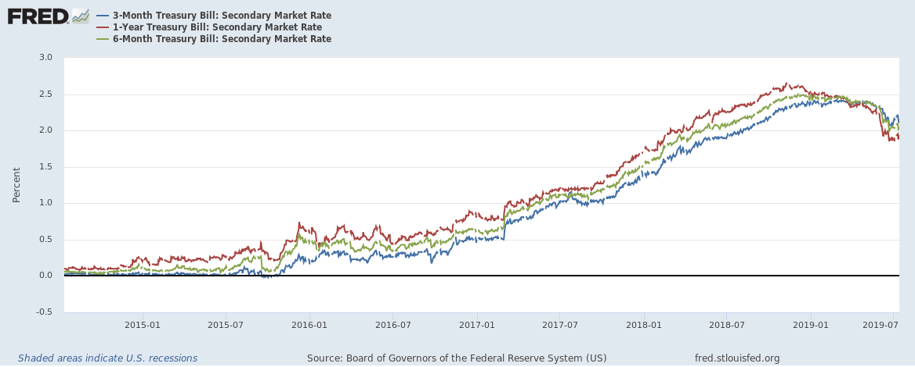
Stylized Facts about economic time series 6. Related economic series tend to co-move systematically

Slide 30
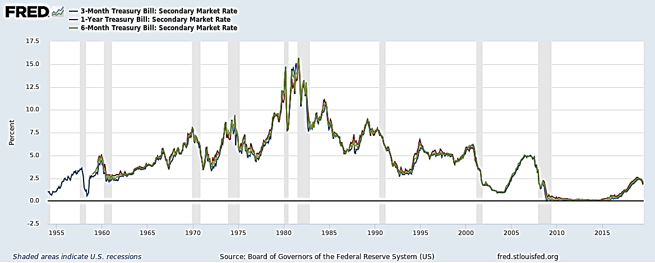
Stylized Facts about economic time series 7. Co-movements reflect relationships with broader economic forces

Slide 31
Overview of Time Series Models

Slide 32
Time Series Models
Stationary
Non-Stationary
Univariate
Models
Multivariate Models
Single Endogenous: ARDL, GARCH
Many Endogenous: VAR, SVAR
Univariate
Deterministic Trends
Stochastic Trends: ARIMA(p,d,q)
Filters
Differencing
Only E(y_{t}): ARMA(p,q)
E(y_{t}) & Var(y_{t}): ARCH
Tests
Multivariate
Cointegration / VECM

Slide 33
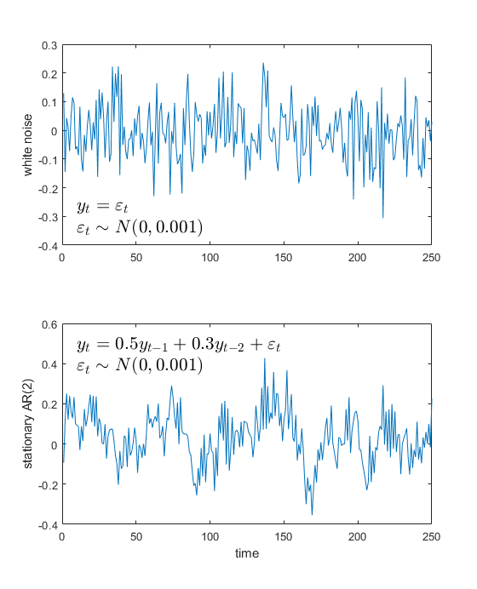
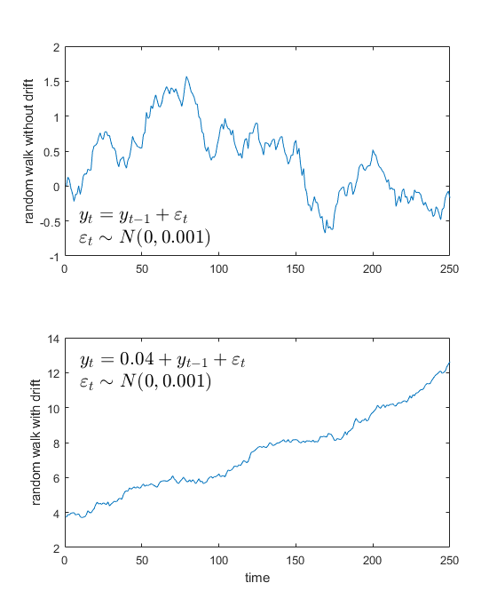
Time Series Models
Stationary
Non-Stationary
Univariate
Models
Multivariate Models
Single Endogenous: ARDL, GARCH
Many Endogenous: VAR, SVAR
Univariate
Deterministic Trends
Stochastic Trends: ARIMA(p,d,q)
Filters
Differencing
Only E(y_{t}): ARMA(p,q)
E(y_{t}) & Var(y_{t}): ARCH
Tests
Multivariate
Cointegration / VECM
Notes:
How does hypothesis testing work in a cross section? The distributional theory underlying hypothesis testing in time series is fundamentally different between stationary vs non-stationary data.

Slide 34
Time Series Models
Stationary
Non-Stationary
Univariate
Models
Multivariate Models
Single Endogenous: ARDL, GARCH
Many Endogenous: VAR, SVAR
Univariate
Deterministic Trends
Stochastic Trends: ARIMA(p,d,q)
Filters
Differencing
Only E(y_{t}): ARMA(p,q)
E(y_{t}) & Var(y_{t}): ARCH
Tests
Multivariate
Cointegration / VECM

Slide 35
Time Series Models
Stationary
Non-Stationary
Univariate
Models
Multivariate Models
Single Endogenous: ARDL, GARCH
Many Endogenous: VAR, SVAR
Univariate
Deterministic Trends
Stochastic Trends: ARIMA(p,d,q)
Filters
Differencing
Only E(y_{t}): ARMA(p,q)
E(y_{t}) & Var(y_{t}): ARCH
Tests
Multivariate
Cointegration / VECM

Slide 36
Time Series Models
Stationary
Non-Stationary
Univariate
Models
Multivariate Models
Single Endogenous: ARDL
Many Endogenous: VAR, SVAR
Univariate
Deterministic Trends
Stochastic Trends: ARIMA(p,d,q)
Filters
Differencing
Only E(y_{t}): ARMA(p,q)
E(y_{t}) & Var(y_{t}): ARCH
Tests
Multivariate
Cointegration / VECM

Slide 37
Time Series Models
Stationary
Non-Stationary
Univariate
Models
Multivariate Models
Single Endogenous: ARDL
Many Endogenous: VAR, SVAR
Univariate
Deterministic Trends
Stochastic Trends: ARIMA(p,d,q)
Filters
Differencing
Only E(y_{t}): ARMA(p,q)
E(y_{t}) & Var(y_{t}): ARCH
Tests
Multivariate
Cointegration / VECM

Slide 38
Time Series Models
Stationary
Non-Stationary
Univariate
Models
Multivariate Models
Single Endogenous: ARDL, GARCH
Many Endogenous: VAR, SVAR
Univariate Concepts
Deterministic Trends
Stochastic Trends: ARIMA(p,d,q)
Filters
Differencing
Only E(y_{t}): ARMA(p,q)
E(y_{t}) & Var(y_{t}): ARCH
Tests
Multivariate
Cointegration / VECM

Slide 39
Time Series Models
Stationary
Non-Stationary
Univariate
Models
Multivariate Models
Single Endogenous: ARDL, GARCH
Many Endogenous: VAR, SVAR
Univariate Concepts
Deterministic Trends & Filters
Stochastic Trends: ARIMA(p,d,q)
Differencing
Only E(y_{t}): ARMA(p,q)
E(y_{t}) & Var(y_{t}): ARCH
Tests
Multivariate
Cointegration / VECM

Slide 40
Time Series Models
Stationary
Non-Stationary
Univariate
Models
Multivariate Models
Single Endogenous: ARDL, GARCH
Many Endogenous: VAR, SVAR
Univariate Concepts
Deterministic Trends & Filters
Stochastic Trends: ARIMA(p,d,q)
Differencing
Only E(y_{t}): ARMA(p,q)
E(y_{t}) & Var(y_{t}): ARCH
Tests
Multivariate
Cointegration / VECM, ARDL

Slide 41
Time Series Models
Stationary
Non-Stationary
Univariate
Models
Multivariate Models
Single Endogenous: ARDL, GARCH
Many Endogenous: VAR, SVAR
Univariate
Deterministic Trends & Filters
Stochastic Trends: ARIMA(p,d,q)
Differencing
Only E(y_{t}): ARMA(p,q)
E(y_{t}) & Var(y_{t}): ARCH
Tests
Multivariate
Cointegration / VECM, ARDL
Model Selection and Forecasting

Slide 42
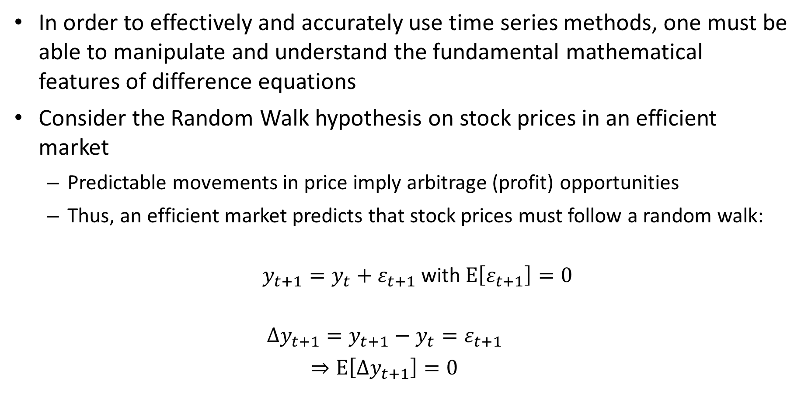
Today: Difference equations
In order to effectively and accurately use time series methods, one must be able to manipulate and understand the fundamental mathematical features of difference equations
Consider the Random Walk hypothesis on stock prices in an efficient market
Predictable movements in price imply arbitrage (profit) opportunities
Thus, an efficient market predicts that stock prices must follow a random walk:
$y_{t+1}=y_{t}+ε_{t+1}$ with $E\left[ε_{t+1}\right]=0$
$$Δy_{t+1}=y_{t+1}−y_{t}=ε_{t+1}$$
$$⇒E\left[Δy_{t+1}\right]=0$$

Slide 43
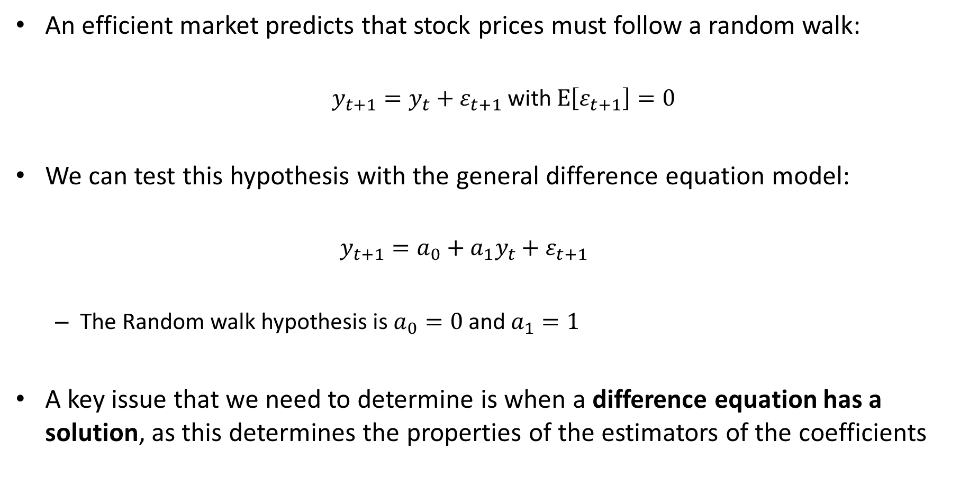
Today: Difference equations
An efficient market predicts that stock prices must follow a random walk:
$y_{t+1}=y_{t}+ε_{t+1}$ with $E\left[ε_{t+1}\right]=0$
We can test this hypothesis with the general difference equation model:
$$y_{t+1}=a_{0}+a_{1}y_{t}+ε_{t+1}$$
The Random walk hypothesis is $a_{0}=0$ and $a_{1}=1$
A key issue that we need to determine is when a difference equation has a solution, as this determines the properties of the estimators of the coefficients

Slide 44
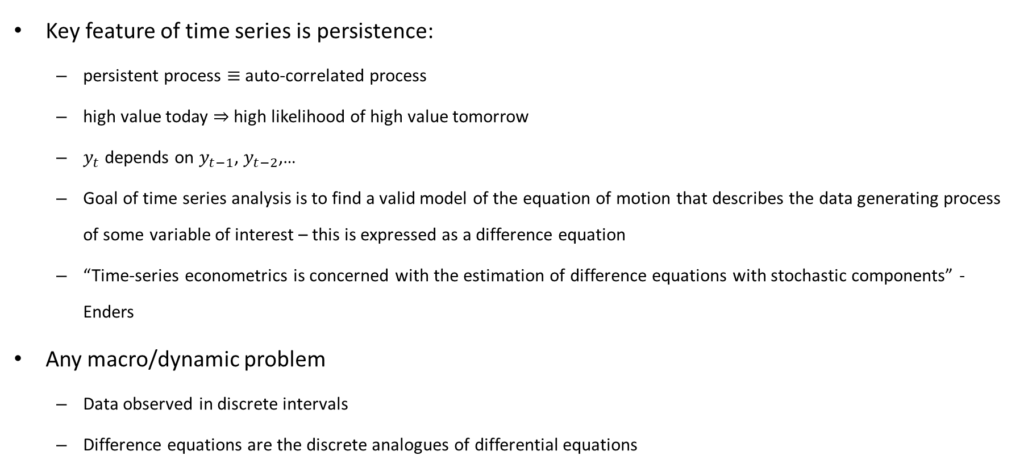
More generally
Key feature of time series is persistence:
persistent process $≡$ auto-correlated process
high value today $⇒$high likelihood of high value tomorrow
$y_{t}$ depends on $y_{t−1}$, $y_{t−2}$,…
Goal of time series analysis is to find a valid model of the equation of motion that describes the data generating process of some variable of interest – this is expressed as a difference equation
“Time-series econometrics is concerned with the estimation of difference equations with stochastic components” - Enders
Any macro/dynamic problem
Data observed in discrete intervals
Difference equations are the discrete analogues of differential equations

Slide 45
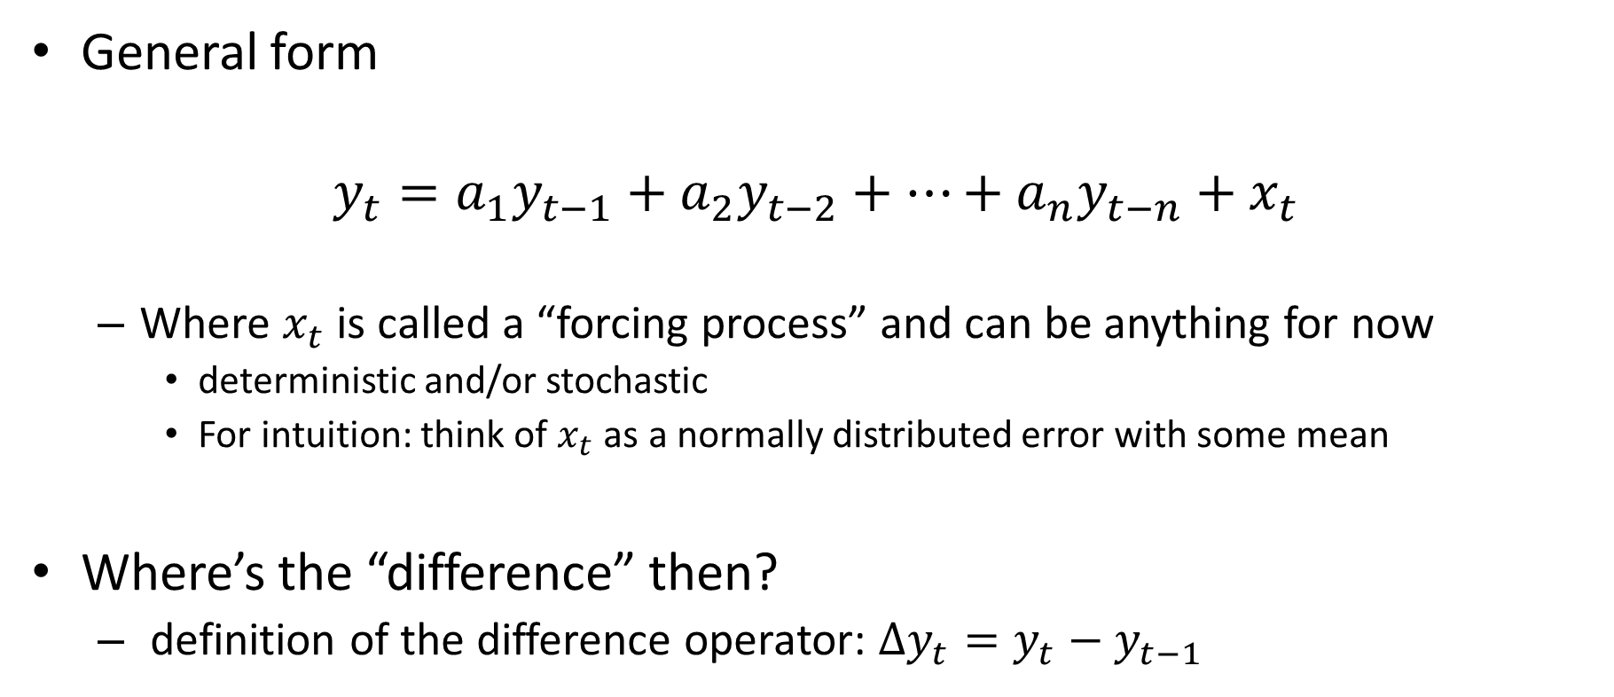
n^{th} order Linear Difference Equations
General form
$$y_{t}=a_{1}y_{t−1}+a_{2}y_{t−2}+…+a_{n}y_{t−n}+x_{t}$$
Where $x_{t}$ is called a “forcing process” and can be anything for now
deterministic and/or stochastic
For intuition: think of $x_{t}$ as a normally distributed error with some mean
Where’s the “difference” then?
definition of the difference operator: $∆y_{t}=y_{t}−y_{t−1}$

Slide 46

n^{th} order Linear Difference Equations
In general form:
$$y_{t}=a_{1}y_{t−1}+a_{2}y_{t−2}+…+a_{n}y_{t−n}+x_{t}$$
Subtract $y_{t−1}$ from both sides:
$$y_{t}−y_{t−1}=a_{1}y_{t−1}−y_{t−1}+a_{2}y_{t−2}+…+a_{n}y_{t−n}+x_{t}$$
$$∆y_{t}=\left(a_{1}−1\right)y_{t−1}+a_{2}y_{t−2}+…+a_{n}y_{t−n}+x_{t}$$

Slide 47
n^{th} order Linear Difference Equations
In general form:
$$y_{t}=a_{1}y_{t−1}+a_{2}y_{t−2}+…+a_{n}y_{t−n}+x_{t}$$
Subtract $y_{t−1}$ from both sides:
$$y_{t}−y_{t−1}=a_{1}y_{t−1}−y_{t−1}+a_{2}y_{t−2}+…+a_{n}y_{t−n}+x_{t}$$
$$∆y_{t}=\left(a_{1}−1\right)y_{t−1}+a_{2}y_{t−2}+…+a_{n}y_{t−n}+x_{t}$$
The change from one period to the next
this linear function the level of past values
and other things that happen in this period
is

Slide 48
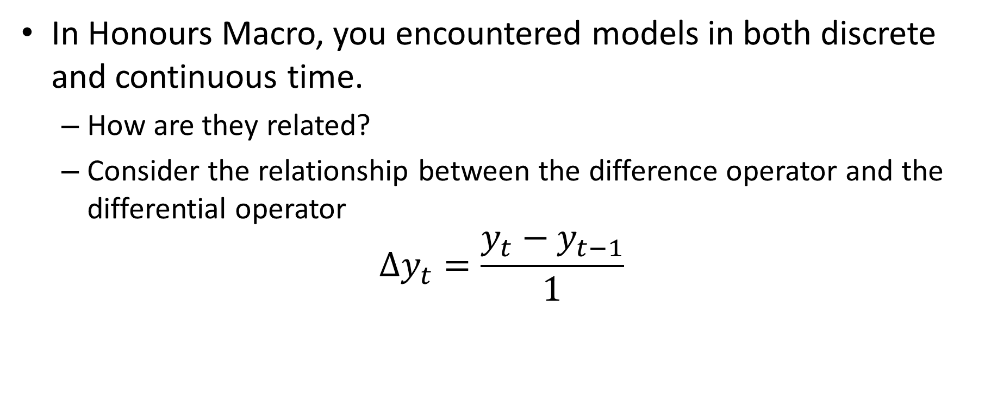
Discrete vs Continuous Time models
In Honours Macro, you encountered models in both discrete and continuous time.
How are they related?
Consider the relationship between the difference operator and the differential operator
$$∆y_{t}=\frac{y_{t}−y_{t−1}}{1}$$

Slide 49

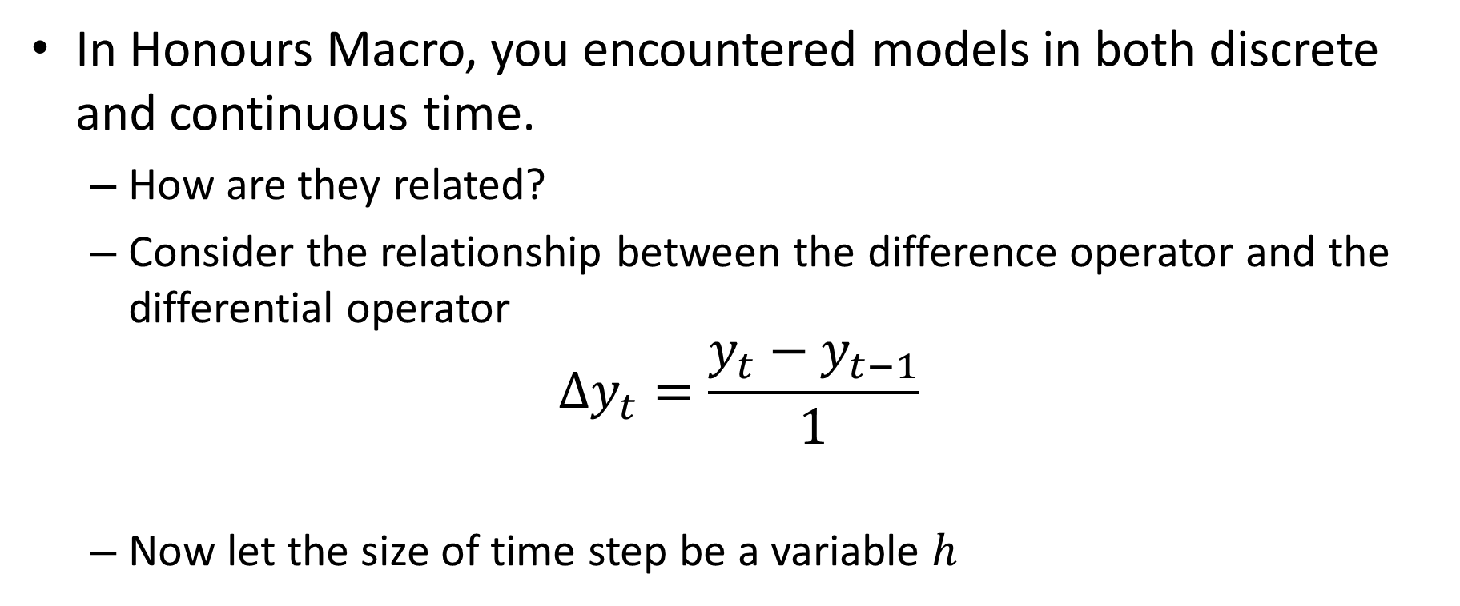
Discrete vs Continuous Time models
In Honours Macro, you encountered models in both discrete and continuous time.
How are they related?
Consider the relationship between the difference operator and the differential operator
$$∆y_{t}=\frac{y_{t}−y_{t−1}}{1}$$
Now let the size of time step be a variable $h$
Size of the change in $y$
Size of the time step in which the change occurs

Slide 50


Discrete vs Continuous Time models
Now let the size of time step be a variable $h$
$$\frac{y_{t}−y_{t−h}}{h}$$
What is the limit?
$$\lim_{h→0}{\frac{y_{t}−y_{t−h}}{h}}$$
Size of the change in $y$
Size of the time step in which the change occurs

Slide 51

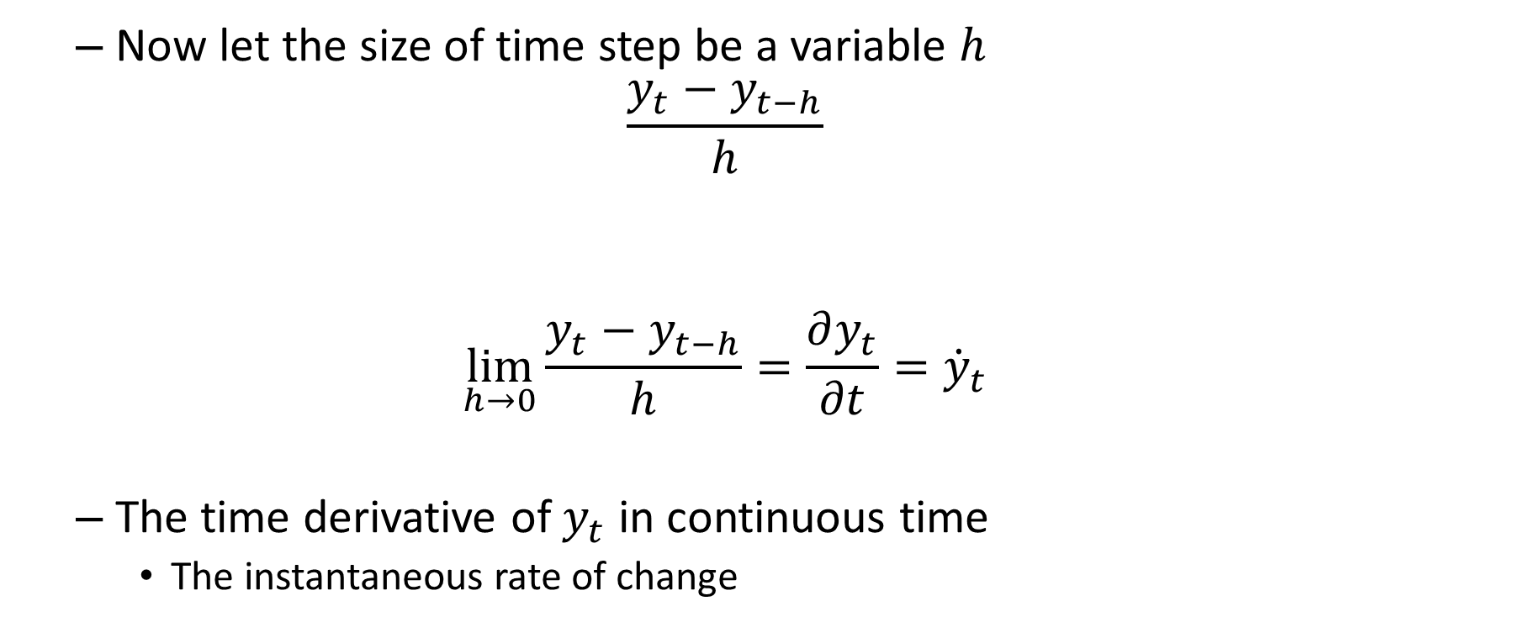
Discrete vs Continuous Time models
Now let the size of time step be a variable $h$
$$\frac{y_{t}−y_{t−h}}{h}$$
$$\lim_{h→0}{\frac{y_{t}−y_{t−h}}{h}}=\frac{∂y_{t}}{∂t}={\dot{y}}_{t}$$
The time derivative of $y_{t}$ in continuous time
The instantaneous rate of change
Size of the change in $y$
Size of the time step in which the change occurs

Slide 52
n^{th} order Linear Difference Equations
What restrictions are we imposing?
I.e. what are we not looking at?

Slide 53
n^{th} order Linear Difference Equations
Linearity
Strong restriction, but remains majority of the core toolkit
Used for estimation of linearized approximations non-linear models
around an equilibrium
Non-linear approaches
Quadratic approximations becoming more feasible (across variables, not across periods)
Higher order?
Non-linearity usually takes different forms
Asymmetric responses to positive/negative shocks
Different behaviours at different ranges of variables/dates

Slide 54

Linear Difference Equations
Constant Parameters
With respect to time, endogenous and forcing variables
Empirical Advances: Time varying coefficients, Regime shifts
Fall under “Non-linear models” – Advanced course
Forcing Process
Current and/or Lagged values of other variables
Deterministic functions of time
Fully specified stochastic processes
(self contained, not function of anything else)
Different choices lead to different models
Keep it simple for now:
Forcing process is deterministic or “white noise”
$$y_{t+1}=a_{0}+a_{1}y_{t}+x_{t+1}$$

Slide 55
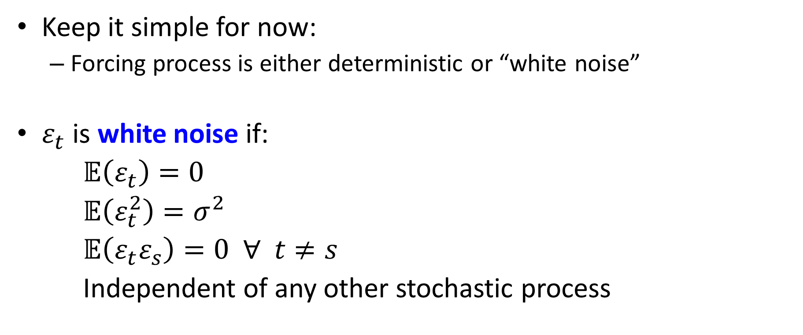
Linear Difference Equations
Keep it simple for now:
Forcing process is either deterministic or “white noise”
$ε_{t}$ is white noise if:
$𝔼\left(ε_{t}\right)=0$
$𝔼\left(ε_{t}^{2}\right)=σ^{2}$
$𝔼\left(ε_{t}ε_{s}\right)=0 ∀ t≠s$
Independent of any other stochastic process

Slide 56
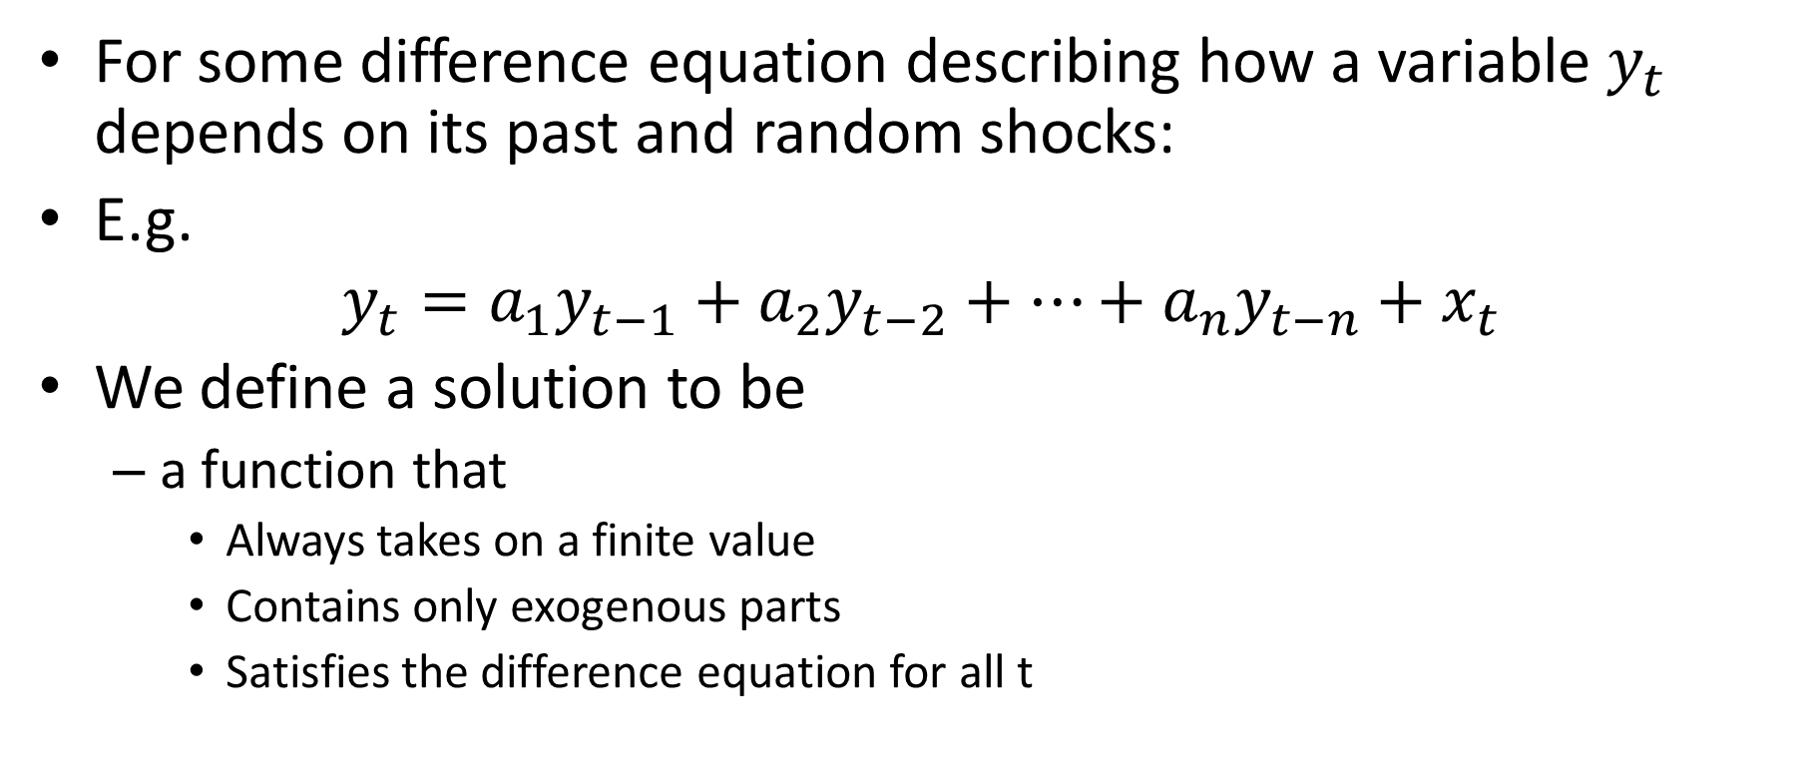
Defining the solution of a difference equation
For some difference equation describing how a variable $y_{t}$ depends on its past and random shocks:
E.g.
$$y_{t}=a_{1}y_{t−1}+a_{2}y_{t−2}+…+a_{n}y_{t−n}+x_{t}$$
We define a solution to be
a function that
Always takes on a finite value
Contains only exogenous parts
Satisfies the difference equation for all t

Slide 57

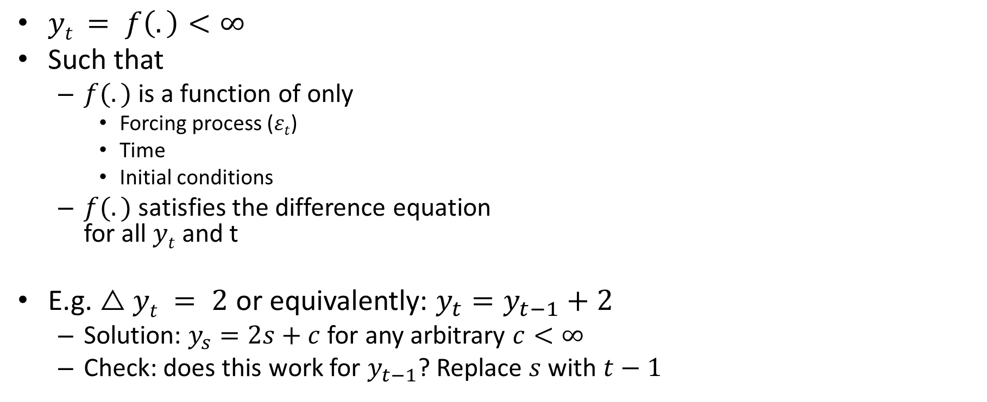
Defining the solution of a difference equation
$yt = f\left(.\right)<∞$
Such that
$f(.)$is a function of only
Forcing process ($εt$)
Time
Initial conditions
$f(.)$satisfies the difference equation for all $yt$ and t
E.g. $△yt = 2$ or equivalently: $y_{t}=y_{t−1}+2$
Solution: $y_{s}=2s+c$ for any arbitrary $c<∞$
Check: does this work for $y_{t−1}$? Replace $s$ with $t−1$
$$y_{t−1}=2\left(t−1\right)+c$$
$$y_{t}=y_{t−1}+2 \\ y_{t}=2\left(t−1\right)+c+2 \\ y_{t}=2t+c$$

Slide 58
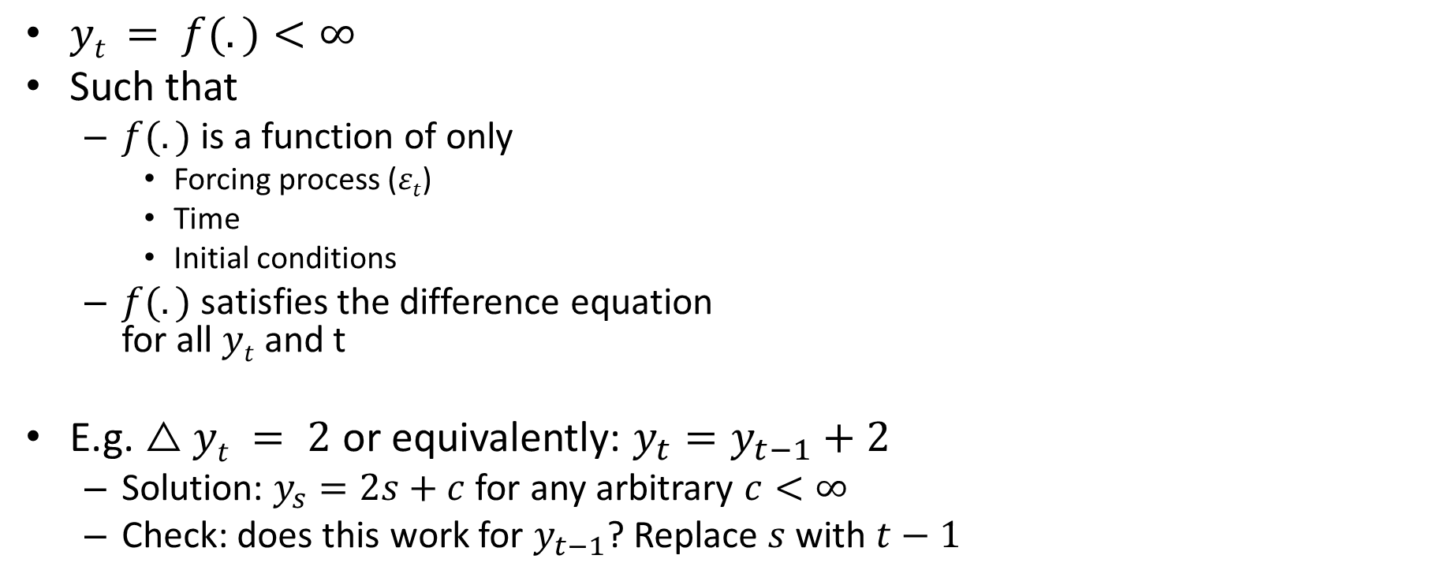
Defining the solution of a difference equation
$yt = f(.)<∞$
Such that
$f(.)$is a function of only
Forcing process ($εt$)
Time
Initial conditions
$f(.)$satisfies the difference equation for all $yt$ and t
E.g. $△yt = 2$ or equivalently: $y_{t}=y_{t−1}+2$
Solution: $y_{s}=2s+c$ for any arbitrary $c<∞$
Check: does this work for $y_{t−1}$? Replace $s$ with $t−1$
$$y_{t−1}=2\left(t−1\right)+c$$
$$y_{t}=y_{t−1}+2 \\ y_{t}=2\left(t−1\right)+c+2 \\ y_{t}=2t+c$$

Slide 59
Defining the solution of a difference equation
$yt = f(.)<∞$
Such that
$f(.)$is a function of only
Forcing process ($εt$)
Time
Initial conditions
$f(.)$satisfies the difference equation for all $yt$ and t
E.g. $△yt = 2$ or equivalently: $y_{t}=y_{t−1}+2$
Solution: $y_{s}=2s+c$ for any arbitrary $c<∞$
Check: does this work for $y_{t−1}$? Replace $s$ with $t−1$
$$y_{t−1}=2\left(t−1\right)+c$$
$$y_{t}=y_{t−1}+2 \\ y_{t}=2\left(t−1\right)+c+2 \\ y_{t}=2t+c$$

Slide 60
Defining the solution of a difference equation
$yt = f(.)<∞$
Such that
$f(.)$is a function of only
Forcing process ($εt$)
Time
Initial conditions
$f(.)$satisfies the difference equation for all $yt$ and t
E.g. $△yt = 2$ or equivalently: $y_{t}=y_{t−1}+2$
Solution: $y_{s}=2s+c$ for any arbitrary $c<∞$
Check: does this work for $y_{t−1}$? Replace $s$ with $t−1$
$$y_{t−1}=2\left(t−1\right)+c$$
$$y_{t}=y_{t−1}+2 \\ y_{t}=2\left(t−1\right)+c+2 \\ y_{t}=2t+c$$

Slide 61
Defining the solution of a difference equation
$yt = f(.)<∞$
Such that
$f(.)$is a function of only
Forcing process ($εt$)
Time
Initial conditions
$f(.)$satisfies the difference equation for all $yt$ and t
E.g. $△yt = 2$ or equivalently: $y_{t}=y_{t−1}+2$
Solution: $y_{s}=2s+c$ for any arbitrary $c<∞$
Check: does this work for $y_{t−1}$? Replace $s$ with $t−1$
$$y_{t−1}=2\left(t−1\right)+c$$
$$y_{t}=y_{t−1}+2 \\ y_{t}=2\left(t−1\right)+c+2 \\ y_{t}=2t+c$$

Slide 62
Solution Methods
Option 1: Iterative
Intuitive
Cumbersome – but worth doing once or twice
With initial value
Direct; either backward* or forward
n^{th} order difference equation requires n initial conditions
Without initial value
Requirements for existence of solution
Uniqueness – “Transversality Conditions”
Application to a first order linear difference equation
Notes:
Do all the handwork here, focus on backward – leave forward as an exercise
First with initial value, then go past, find infinite limit
|a|<1
a^(t+m) y_(t-m) approaches zero
Show convergent geo series result
Substitution
Add Ca^t, show that it is also a solution. Start with primitive form of diff equation.
Unit root case

Slide 63
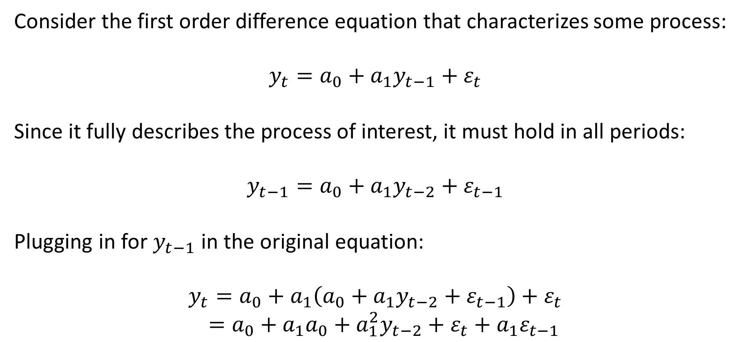
Solution by backwards iteration
Consider the first order difference equation that characterizes some process:
$$y_{t}=a_{0}+a_{1}y_{t−1}+ε_{t}$$
Since it fully describes the process of interest, it must hold in all periods:
$$y_{t−1}=a_{0}+a_{1}y_{t−2}+ε_{t−1}$$
Plugging in for $y_{t−1}$ in the original equation:
$$y_{t}=a_{0}+a_{1}\left(a_{0}+a_{1}y_{t−2}+ε_{t−1}\right)+ε_{t}$$
$=a_{0}+a_{1}a_{0}+a_{1}^{2}y_{t−2}+ε_{t}+a_{1}ε_{t−1}$

Slide 64

Solution by backwards iteration
Similarly:
$$y_{t−2}=a_{0}+a_{1}y_{t−3}+ε_{t−2}$$
Plugging in for $y_{t−2}$:
$$y_{t}=a_{0}+a_{1}\left(a_{0}+a_{1}y_{t−2}+ε_{t−1}\right)+ε_{t}$$
$$=a_{0}+a_{1}a_{0}+a_{1}^{2}y_{t−2}+ε_{t}+a_{1}ε_{t−1}$$
$$=a_{0}+a_{1}a_{0}+a_{1}^{2}\left(a_{0}+a_{1}y_{t−3}+ε_{t−2}\right)+ε_{t}+a_{1}ε_{t−1}$$
$$=a_{0}+a_{1}a_{0}+a_{1}^{2}a_{0}+a_{1}^{3}y_{t−3}+ε_{t}+a_{1}ε_{t−1}+a_{1}^{2}ε_{t−2}$$

Slide 65
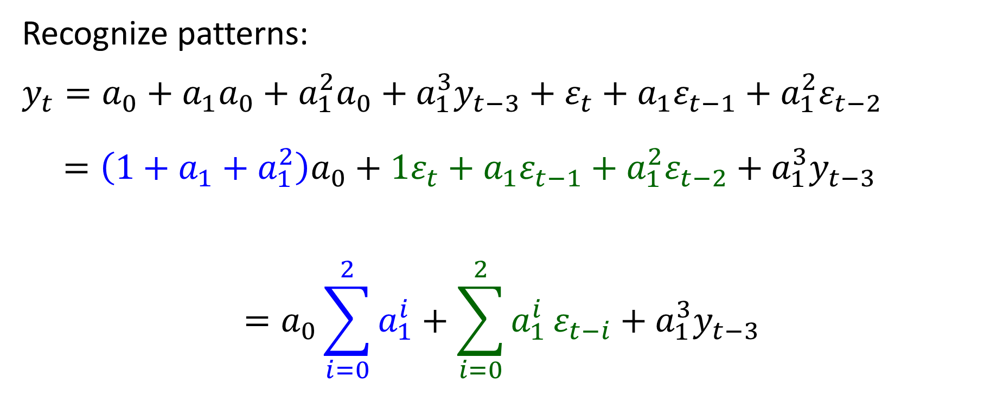
Solution by backwards iteration
Recognize patterns:
$$y_{t}=a_{0}+a_{1}a_{0}+a_{1}^{2}a_{0}+a_{1}^{3}y_{t−3}+ε_{t}+a_{1}ε_{t−1}+a_{1}^{2}ε_{t−2}$$
$=\left(1+a_{1}+a_{1}^{2}\right)a_{0}+1ε_{t}+a_{1}ε_{t−1}+a_{1}^{2}ε_{t−2}+a_{1}^{3}y_{t−3}$
$$=a_{0}\sum_{i=0}^{2}{a_{1}^{i}}+\sum_{i=0}^{2}{a_{1}^{i}}ε_{t−i}+a_{1}^{3}y_{t−3}$$

Slide 66
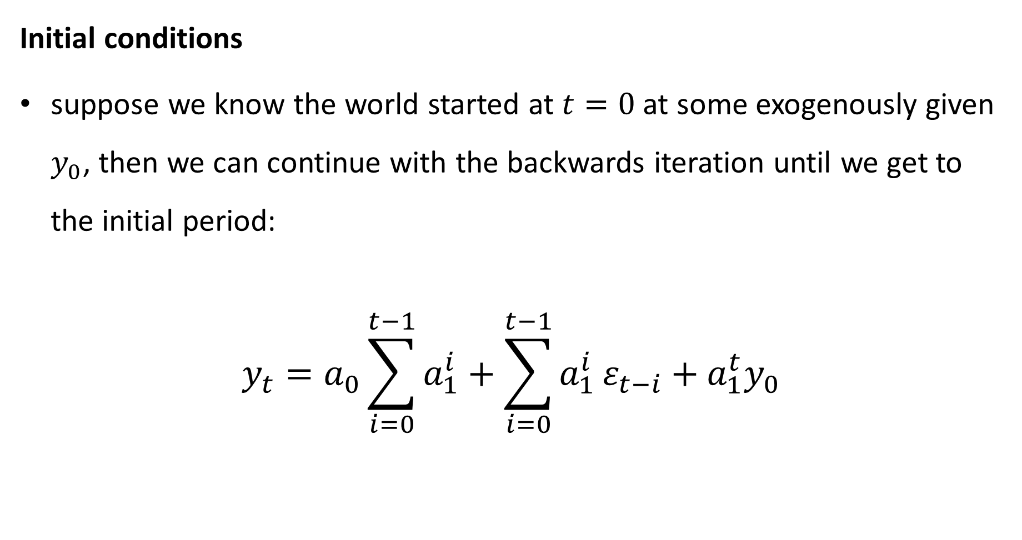
Solution by backwards iteration
Initial conditions
suppose we know the world started at $t=0$ at some exogenously given $y_{0}$, then we can continue with the backwards iteration until we get to the initial period:
$$y_{t}=a_{0}\sum_{i=0}^{t−1}{a_{1}^{i}}+\sum_{i=0}^{t−1}{a_{1}^{i}}ε_{t−i}+a_{1}^{t}y_{0}$$

Slide 67
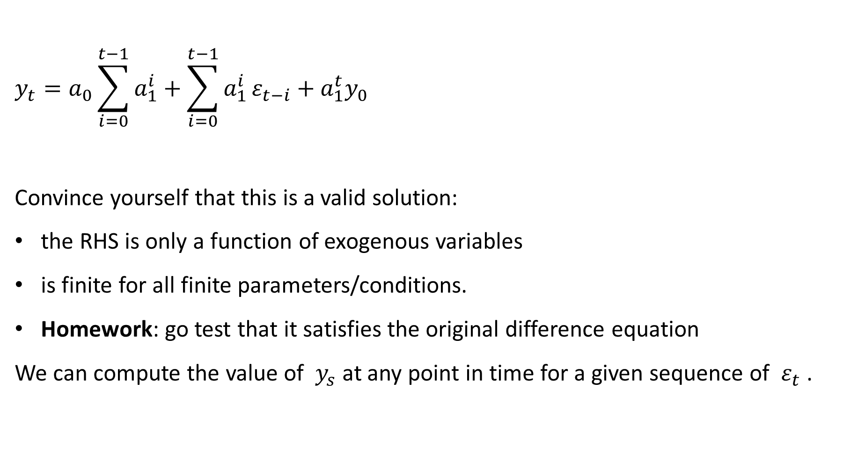
Solution by backwards iteration
$$y_{t}=a_{0}\sum_{i=0}^{t−1}{a_{1}^{i}}+\sum_{i=0}^{t−1}{a_{1}^{i}}ε_{t−i}+a_{1}^{t}y_{0}$$
Convince yourself that this is a valid solution:
the RHS is only a function of exogenous variables
is finite for all finite parameters/conditions.
Homework: go test that it satisfies the original difference equation
We can compute the value of $y_{s}$ at any point in time for a given sequence of $ε_{t}$ .

Slide 68
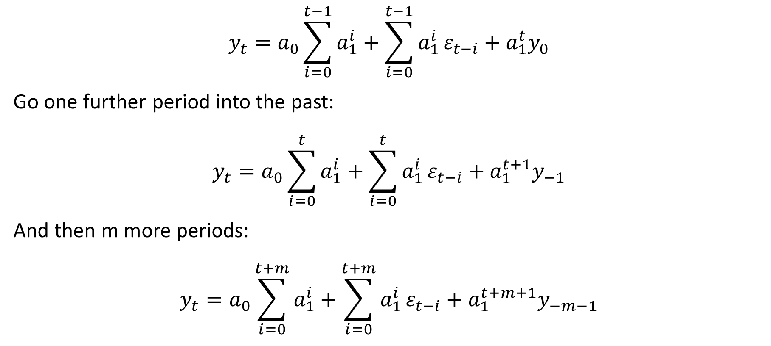
Solution by backwards iteration
$$y_{t}=a_{0}\sum_{i=0}^{t−1}{a_{1}^{i}}+\sum_{i=0}^{t−1}{a_{1}^{i}}ε_{t−i}+a_{1}^{t}y_{0}$$
Go one further period into the past:
$$y_{t}=a_{0}\sum_{i=0}^{t}{a_{1}^{i}}+\sum_{i=0}^{t}{a_{1}^{i}}ε_{t−i}+a_{1}^{t+1}y_{−1}$$
And then m more periods:
$$y_{t}=a_{0}\sum_{i=0}^{t+m}{a_{1}^{i}}+\sum_{i=0}^{t+m}{a_{1}^{i}}ε_{t−i}+a_{1}^{t+m+1}y_{−m−1}$$

Slide 69
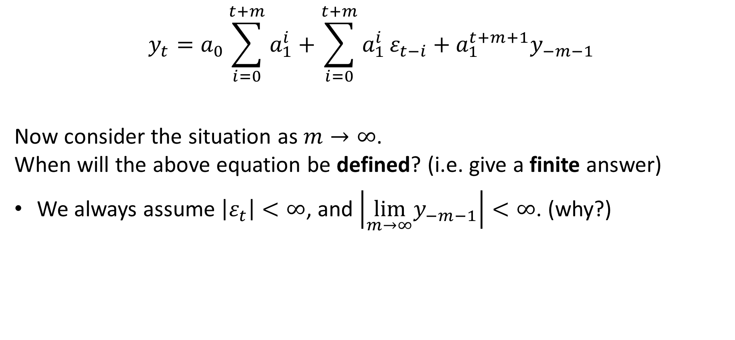
Solution by backwards iteration
$$y_{t}=a_{0}\sum_{i=0}^{t+m}{a_{1}^{i}}+\sum_{i=0}^{t+m}{a_{1}^{i}}ε_{t−i}+a_{1}^{t+m+1}y_{−m−1}$$
Now consider the situation as $m→∞$. When will the above equation be defined? (i.e. give a finite answer)
We always assume $\left|ε_{t}\right|<∞$, and $\left|\lim_{m→∞}y_{−m−1}\right|<∞$. (why?)

Slide 70
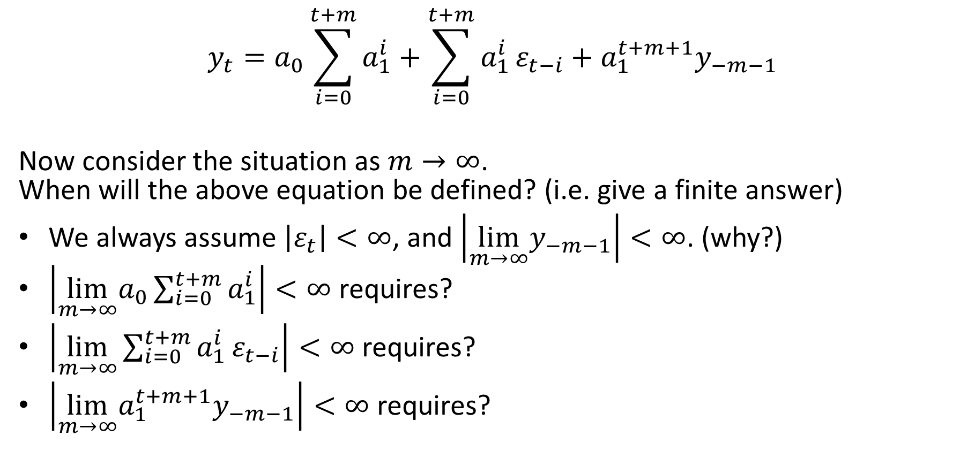
Solution by backwards iteration
$$y_{t}=a_{0}\sum_{i=0}^{t+m}{a_{1}^{i}}+\sum_{i=0}^{t+m}{a_{1}^{i}}ε_{t−i}+a_{1}^{t+m+1}y_{−m−1}$$
Now consider the situation as $m→∞$. When will the above equation be defined? (i.e. give a finite answer)
We always assume $\left|ε_{t}\right|<∞$, and $\left|\lim_{m→∞}y_{−m−1}\right|<∞$. (why?)
$\left|\lim_{m→∞}a_{0}\sum_{i=0}^{t+m}{a_{1}^{i}}\right|<∞$ requires?
$\left|\lim_{m→∞}\sum_{i=0}^{t+m}{a_{1}^{i}}ε_{t−i}\right|<∞$ requires?
$\left|\lim_{m→∞}a_{1}^{t+m+1}y_{−m−1}\right|<∞$ requires?

Slide 71
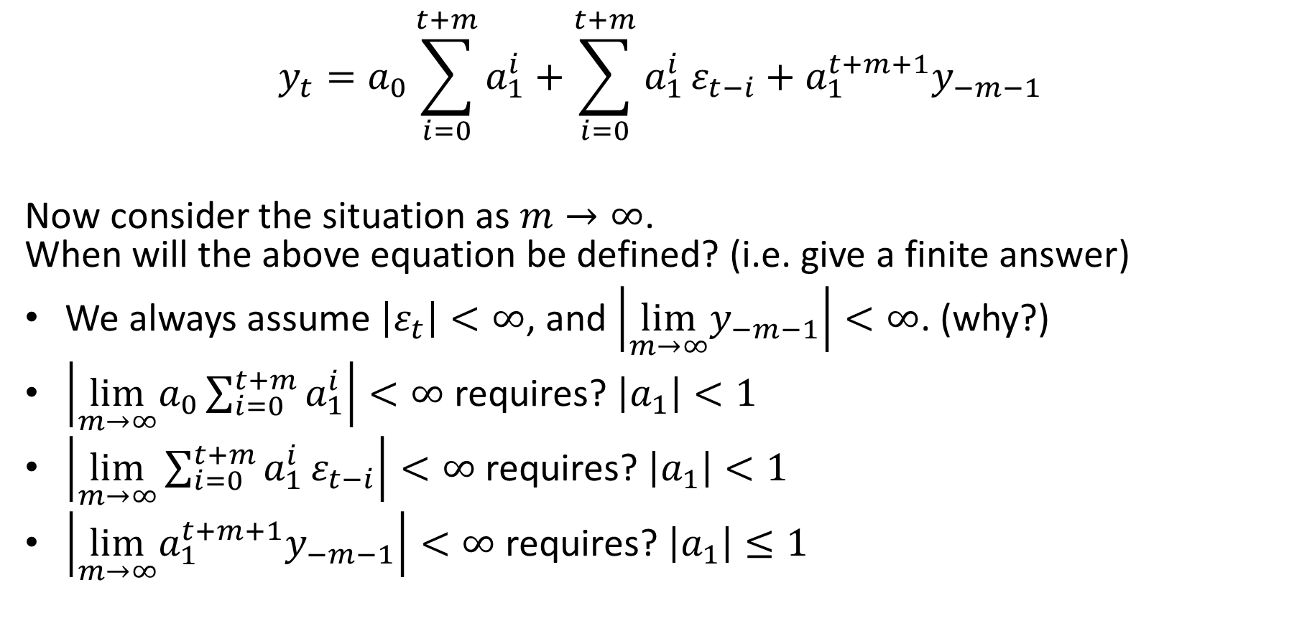
Solution by backwards iteration
$$y_{t}=a_{0}\sum_{i=0}^{t+m}{a_{1}^{i}}+\sum_{i=0}^{t+m}{a_{1}^{i}}ε_{t−i}+a_{1}^{t+m+1}y_{−m−1}$$
Now consider the situation as $m→∞$. When will the above equation be defined? (i.e. give a finite answer)
We always assume $\left|ε_{t}\right|<∞$, and $\left|\lim_{m→∞}y_{−m−1}\right|<∞$. (why?)
$\left|\lim_{m→∞}a_{0}\sum_{i=0}^{t+m}{a_{1}^{i}}\right|<∞$ requires? $\left|a_{1}\right|<1$
$\left|\lim_{m→∞}\sum_{i=0}^{t+m}{a_{1}^{i}}ε_{t−i}\right|<∞$ requires? $\left|a_{1}\right|<1$
$\left|\lim_{m→∞}a_{1}^{t+m+1}y_{−m−1}\right|<∞$ requires? $\left|a_{1}\right|≤1$

Slide 72

Convergent geometric series
If $\left|a_{1}\right|<1$ , the first term forms a convergent geometric series
$$\sum_{i=0}^{m}{a_{1}^{i}}=1+a_{1}+a_{1}^{2}+…+a_{1}^{m}$$
$$\lim_{m→∞} \sum_{i=0}^{m}{a_{1}^{i}}=1+a_{1}+a_{1}^{2}+…$$
Suppose the limit $x$ exists:
$$x=1+a_{1}+a_{1}^{2}+…$$
$$a_{1}x= a_{1}+a_{1}^{2}+…$$
$$x −a_{1}x=1$$
$$x=\frac{1}{1−a_{1}}$$

Slide 73

Solution by backwards iteration
$$y_{t}=a_{0}\sum_{i=0}^{t+m}{a_{1}^{i}}+\sum_{i=0}^{t+m}{a_{1}^{i}}ε_{t−i}+a_{1}^{t+m+1}y_{−m−1}$$
If $\left|a_{1}\right|<1$
$$\lim_{m→∞}a_{0}\sum_{i=0}^{t+m}{a_{1}^{i}}=\frac{a_{0}}{1−a_{1}}$$
$$\lim_{m→∞}\sum_{i=0}^{t+m}{a_{1}^{i}}ε_{t−i}=\sum_{i=0}^{∞}{a_{1}^{i}}ε_{t−i}<∞$$
$$\lim_{m→∞}a_{1}^{t+m+1}y_{−m−1}=0$$

Slide 74
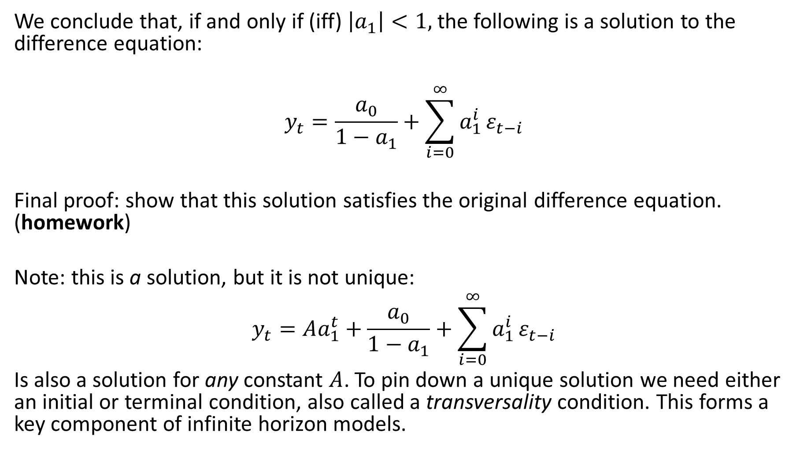
Solution by backwards iteration
We conclude that, if and only if (iff) $\left|a_{1}\right|<1,$the following is a solution to the difference equation:
$$y_{t}=\frac{a_{0}}{1−a_{1}}+\sum_{i=0}^{∞}{a_{1}^{i}}ε_{t−i}$$
Final proof: show that this solution satisfies the original difference equation. (homework)
Note: this is a solution, but it is not unique:
$$y_{t}=Aa_{1}^{t}+\frac{a_{0}}{1−a_{1}}+\sum_{i=0}^{∞}{a_{1}^{i}}ε_{t−i}$$
Is also a solution for any constant $A$. To pin down a unique solution we need either an initial or terminal condition, also called a transversality condition. This forms a key component of infinite horizon models.

Slide 75
Solution Methods
Option 1: Iterative
Option 2: General Solution Method
Algorithm
not easily teachable but learnable (and lookup-able)
Method of undetermined coefficients

Slide 76
Solution Methods
Option 1: Iterative
Option 2: General Solution Method
Algorithm not easily teachable but learnable (and lookup-able)
Applicable to linear difference equation of any order
Iterative version quickly becomes too messy

Slide 77
Why do we want to solve them?
Different time series behaviour is generated by different difference equations.
One part of estimating a model is to “know” what type of behaviour is typically observed from each type of difference equation (different coefficient values, different orders, different forcing processes) so that we can use the correct model in the estimation
The solutions tell us exactly how the variable will evolve from any starting point
Will the process return to its mean or wander about or explode?
If it is mean reverting, does it do so directly or in an oscillatory pattern?
Determines the distribution of estimators of coefficients

Slide 78
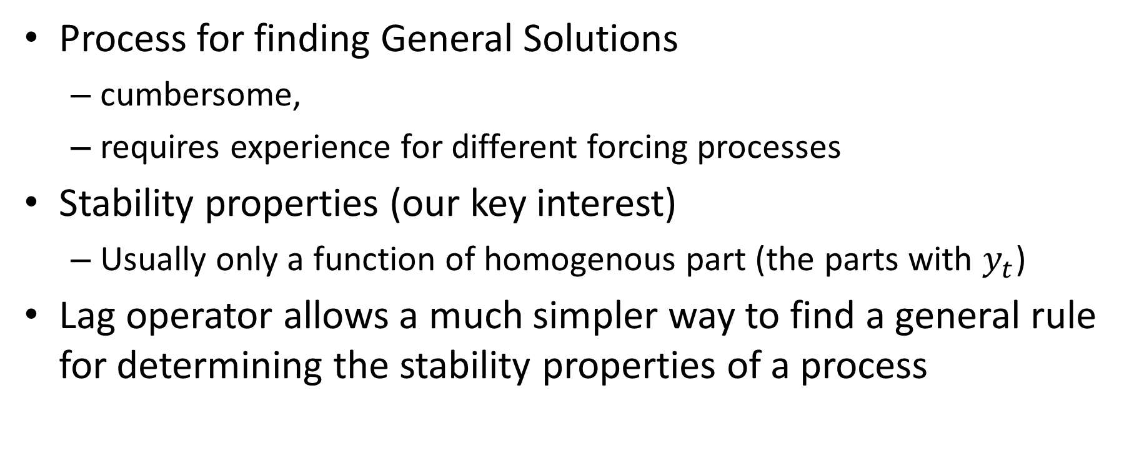
Lag operator
Process for finding General Solutions
cumbersome,
requires experience for different forcing processes
Stability properties (our key interest)
Usually only a function of homogenous part (the parts with $y_{t}$)
Lag operator allows a much simpler way to find a general rule for determining the stability properties of a process

Slide 79
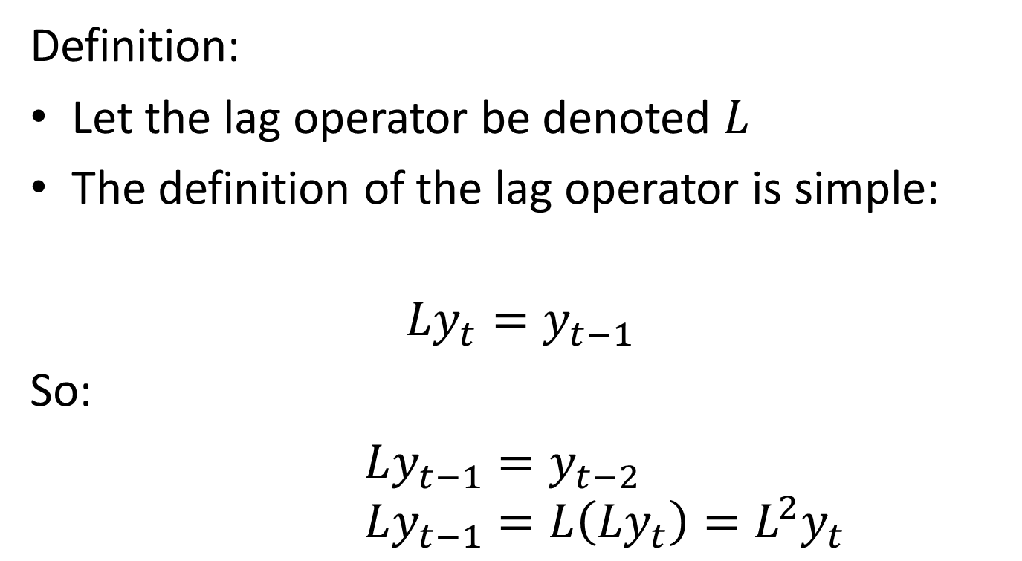
Lag operator
Definition:
Let the lag operator be denoted $L$
The definition of the lag operator is simple:
$$Ly_{t}=y_{t−1}$$
So:
$Ly_{t−1}=y_{t−2}$ $Ly_{t−1}=L\left(Ly_{t}\right)=L^{2}y_{t}$

Slide 80
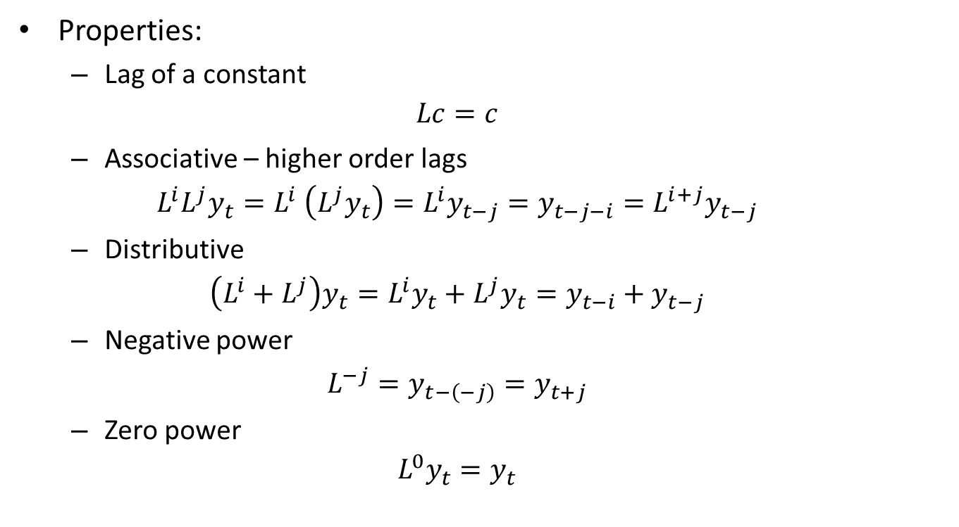
Lag operator
Properties:
Lag of a constant
$$Lc=c$$
Associative – higher order lags
$$L^{i}L^{j}y_{t}=L^{i} \left(L^{j}y_{t}\right)=L^{i}y_{t−j}=y_{t−j−i}=L^{i+j}y_{t−j}$$
Distributive
$$\left(L^{i}+L^{j}\right)y_{t}=L^{i}y_{t}+L^{j}y_{t}=y_{t−i}+y_{t−j}$$
Negative power
$$L^{−j}=y_{t−\left(−j\right)}=y_{t+j}$$
Zero power
$$L^{0}y_{t}=y_{t}$$

Slide 81
Lag operator
Properties:
Lag of a constant
$$Lc=c$$
Associative – higher order lags
$$L^{i}L^{j}y_{t}=L^{i} \left(L^{j}y_{t}\right)=L^{i}y_{t−j}=y_{t−j−i}=L^{i+j}y_{t−j}$$
Distributive
$$\left(L^{i}+L^{j}\right)y_{t}=L^{i}y_{t}+L^{j}y_{t}=y_{t−i}+y_{t−j}$$
Negative power
$$L^{−j}=y_{t−\left(−j\right)}=y_{t+j}$$
Zero power
$$L^{0}y_{t}=y_{t}$$

Slide 82

Lag operator
Properties:
Lag of a constant
$$Lc=c$$
Associative – higher order lags
$$L^{i}L^{j}y_{t}=L^{i} \left(L^{j}y_{t}\right)=L^{i}y_{t−j}=y_{t−j−i}=L^{i+j}y_{t}$$
Distributive
$$\left(L^{i}+L^{j}\right)y_{t}=L^{i}y_{t}+L^{j}y_{t}=y_{t−i}+y_{t−j}$$
Negative power
$$L^{−j}=y_{t−\left(−j\right)}=y_{t+j}$$
Zero power
$$L^{0}y_{t}=y_{t}$$

Slide 83
Lag operator
Properties:
Lag of a constant
$$Lc=c$$
Associative – higher order lags
$$L^{i}L^{j}y_{t}=L^{i} \left(L^{j}y_{t}\right)=L^{i}y_{t−j}=y_{t−j−i}=L^{i+j}y_{t}$$
Distributive
$$\left(L^{i}+L^{j}\right)y_{t}=L^{i}y_{t}+L^{j}y_{t}=y_{t−i}+y_{t−j}$$
Negative power
$$L^{−j}=y_{t−\left(−j\right)}=y_{t+j}$$
Zero power
$$L^{0}y_{t}=y_{t}$$

Slide 84
Lag operator
Properties:
Lag of a constant
$$Lc=c$$
Associative – higher order lags
$$L^{i}L^{j}y_{t}=L^{i} \left(L^{j}y_{t}\right)=L^{i}y_{t−j}=y_{t−j−i}=L^{i+j}y_{t}$$
Distributive
$$\left(L^{i}+L^{j}\right)y_{t}=L^{i}y_{t}+L^{j}y_{t}=y_{t−i}+y_{t−j}$$
Negative power
$$L^{−j}=y_{t−\left(−j\right)}=y_{t+j}$$
Zero power
$$L^{0}y_{t}=y_{t}$$

Slide 85

Lag operator
Properties:
Lag of a constant
$$Lc=c$$
Associative – higher order lags
$$L^{i}L^{j}y_{t}=L^{i} \left(L^{j}y_{t}\right)=L^{i}y_{t−j}=y_{t−j−i}=L^{i+j}y_{t}$$
Distributive
$$\left(L^{i}+L^{j}\right)y_{t}=L^{i}y_{t}+L^{j}y_{t}=y_{t−i}+y_{t−j}$$
Negative power
$$L^{−j}=y_{t−\left(−j\right)}=y_{t+j}$$
Zero power
$$L^{0}y_{t}=y_{t}$$

Slide 86

Using Lag Operator to rewrite n^{th} order Linear Difference Equation
Consider a typical n^{th} order Linear Difference Equation
$$y_{t}=a_{0}+a_{1}y_{t−1}+a_{2}y_{t−2}+…+a_{n}y_{t−n}+ε_{t}$$
Using the properties of the lag operator:
$$y_{t}=a_{0}+a_{1}Ly_{t}+a_{2}L^{2}y_{t}+…+a_{n}L^{n}y_{t}+ε_{t}$$
$$=a_{0}+\left(a_{1}L+a_{2}L^{2}+…+a_{n}L^{n}\right)y_{t}+ε_{t}$$
Since everything is now in terms of $y_{t}$, we can collect terms on the LHS:
$$\left(1−a_{1}L−a_{2}L^{2}−…−a_{n}L^{n}\right)y_{t}=a_{0}+ε_{t}$$

Slide 87
Using Lag Operator to rewrite n^{th} order Linear Difference Equation
Consider a typical n^{th} order Linear Difference Equation
$$y_{t}=a_{0}+a_{1}y_{t−1}+a_{2}y_{t−2}+…+a_{n}y_{t−n}+ε_{t}$$
Using the properties of the lag operator:
$$y_{t}=a_{0}+a_{1}Ly_{t}+a_{2}L^{2}y_{t}+…+a_{n}L^{n}y_{t}+ε_{t}$$
$$=a_{0}+\left(a_{1}L+a_{2}L^{2}+…+a_{n}L^{n}\right)y_{t}+ε_{t}$$
Since everything is now in terms of $y_{t}$, we can collect terms on the LHS:
$$\left(1−a_{1}L−a_{2}L^{2}−…−a_{n}L^{n}\right)y_{t}=a_{0}+ε_{t}$$

Slide 88
Using Lag Operator to rewrite n^{th} order Linear Difference Equation
Consider a typical n^{th} order Linear Difference Equation
$$y_{t}=a_{0}+a_{1}y_{t−1}+a_{2}y_{t−2}+…+a_{n}y_{t−n}+ε_{t}$$
Using the properties of the lag operator:
$$y_{t}=a_{0}+a_{1}Ly_{t}+a_{2}L^{2}y_{t}+…+a_{n}L^{n}y_{t}+ε_{t}$$
$$=a_{0}+\left(a_{1}L+a_{2}L^{2}+…+a_{n}L^{n}\right)y_{t}+ε_{t}$$
Since everything is now in terms of $y_{t}$, we can collect terms on the LHS:
$$\left(1−a_{1}L−a_{2}L^{2}−…−a_{n}L^{n}\right)y_{t}=a_{0}+ε_{t}$$

Slide 89
Using Lag Operator to rewrite n^{th} order Linear Difference Equation
Consider a typical n^{th} order Linear Difference Equation
$$y_{t}=a_{0}+a_{1}y_{t−1}+a_{2}y_{t−2}+…+a_{n}y_{t−n}+ε_{t}$$
Using the properties of the lag operator:
$$y_{t}=a_{0}+a_{1}Ly_{t}+a_{2}L^{2}y_{t}+…+a_{n}L^{n}y_{t}+ε_{t}$$
$$=a_{0}+\left(a_{1}L+a_{2}L^{2}+…+a_{n}L^{n}\right)y_{t}+ε_{t}$$
Since everything is now in terms of $y_{t}$, we can collect terms on the LHS:
$$\left(1−a_{1}L−a_{2}L^{2}−…−a_{n}L^{n}\right)y_{t}=a_{0}+ε_{t}$$

Slide 90
Using Lag Operator to rewrite n^{th} order Linear Difference Equation
Consider a typical n^{th} order Linear Difference Equation
$$y_{t}=a_{0}+a_{1}y_{t−1}+a_{2}y_{t−2}+…+a_{n}y_{t−n}+ε_{t}$$
Using the properties of the lag operator:
$$y_{t}=a_{0}+a_{1}Ly_{t}+a_{2}L^{2}y_{t}+…+a_{n}L^{n}y_{t}+ε_{t}$$
$$=a_{0}+\left(a_{1}L+a_{2}L^{2}+…+a_{n}L^{n}\right)y_{t}+ε_{t}$$
Since everything is now in terms of $y_{t}$, we can collect terms on the LHS:
$$\left(1−a_{1}L−a_{2}L^{2}−…−a_{n}L^{n}\right)y_{t}=a_{0}+ε_{t}$$
Notes:
Up to this point, we have used standard arguments

Slide 91
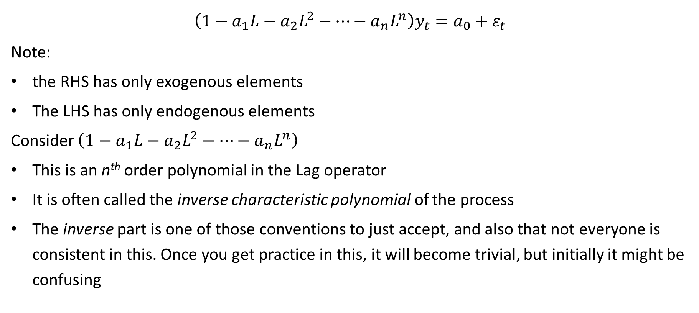
Using Lag Operator to rewrite n^{th} order Linear Difference Equation
$$\left(1−a_{1}L−a_{2}L^{2}−…−a_{n}L^{n}\right)y_{t}=a_{0}+ε_{t}$$
Note:
the RHS has only exogenous elements
The LHS has only endogenous elements
Consider $\left(1−a_{1}L−a_{2}L^{2}−…−a_{n}L^{n}\right)$
This is an n^{th} order polynomial in the Lag operator
It is often called the inverse characteristic polynomial of the process
The inverse part is one of those conventions to just accept, and also that not everyone is consistent in this. Once you get practice in this, it will become trivial, but initially it might be confusing
Notes:
Up to this point, we have used standard arguments

Slide 92
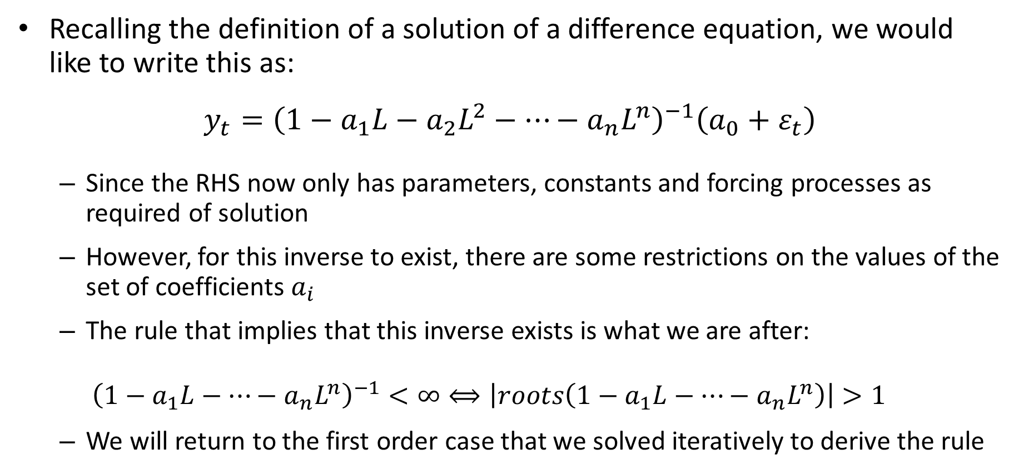
Using Lag Operator to rewrite n^{th} order Linear Difference Equation
Recalling the definition of a solution of a difference equation, we would like to write this as:
$$y_{t}={\left(1−a_{1}L−a_{2}L^{2}−…−a_{n}L^{n}\right)}^{−1}\left(a_{0}+ε_{t}\right)$$
Since the RHS now only has parameters, constants and forcing processes as required of solution
However, for this inverse to exist, there are some restrictions on the values of the set of coefficients $a_{i}$
The rule that implies that this inverse exists is what we are after:
$${\left(1−a_{1}L−…−a_{n}L^{n}\right)}^{−1}<∞⟺\left|roots\left(1−a_{1}L−…−a_{n}L^{n}\right)\right|>1$$
We will return to the first order case that we solved iteratively to derive the rule
Notes:
What are the roots of a function?

Slide 93
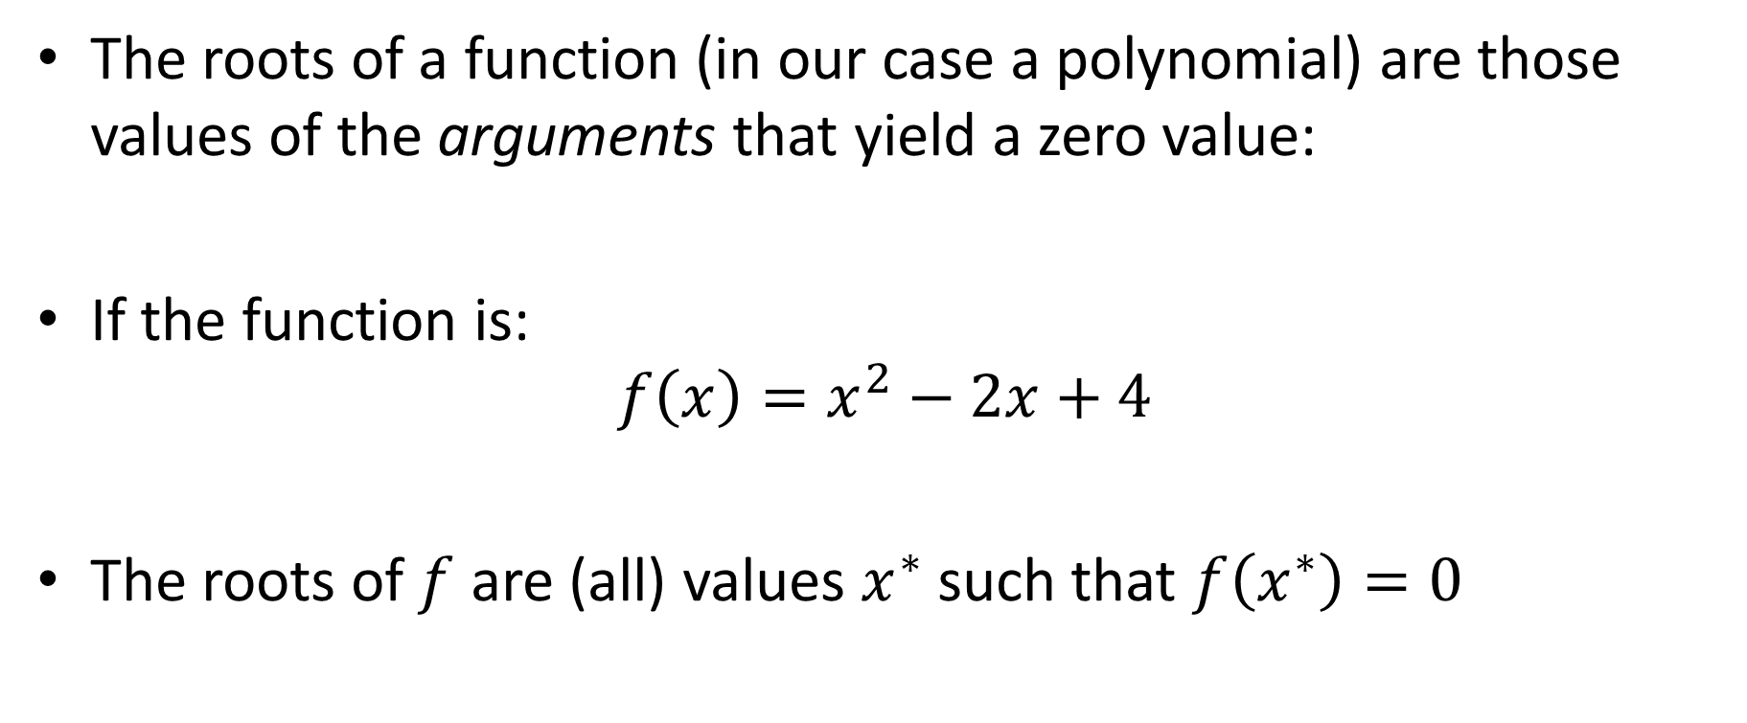
Review: roots of a polynomial
The roots of a function (in our case a polynomial) are those values of the arguments that yield a zero value:
If the function is:
$$f\left(x\right)=x^{2}−2x+4$$
The roots of $f$ are (all) values $x^{∗}$ such that $f\left(x^{∗}\right)=0$

Slide 94
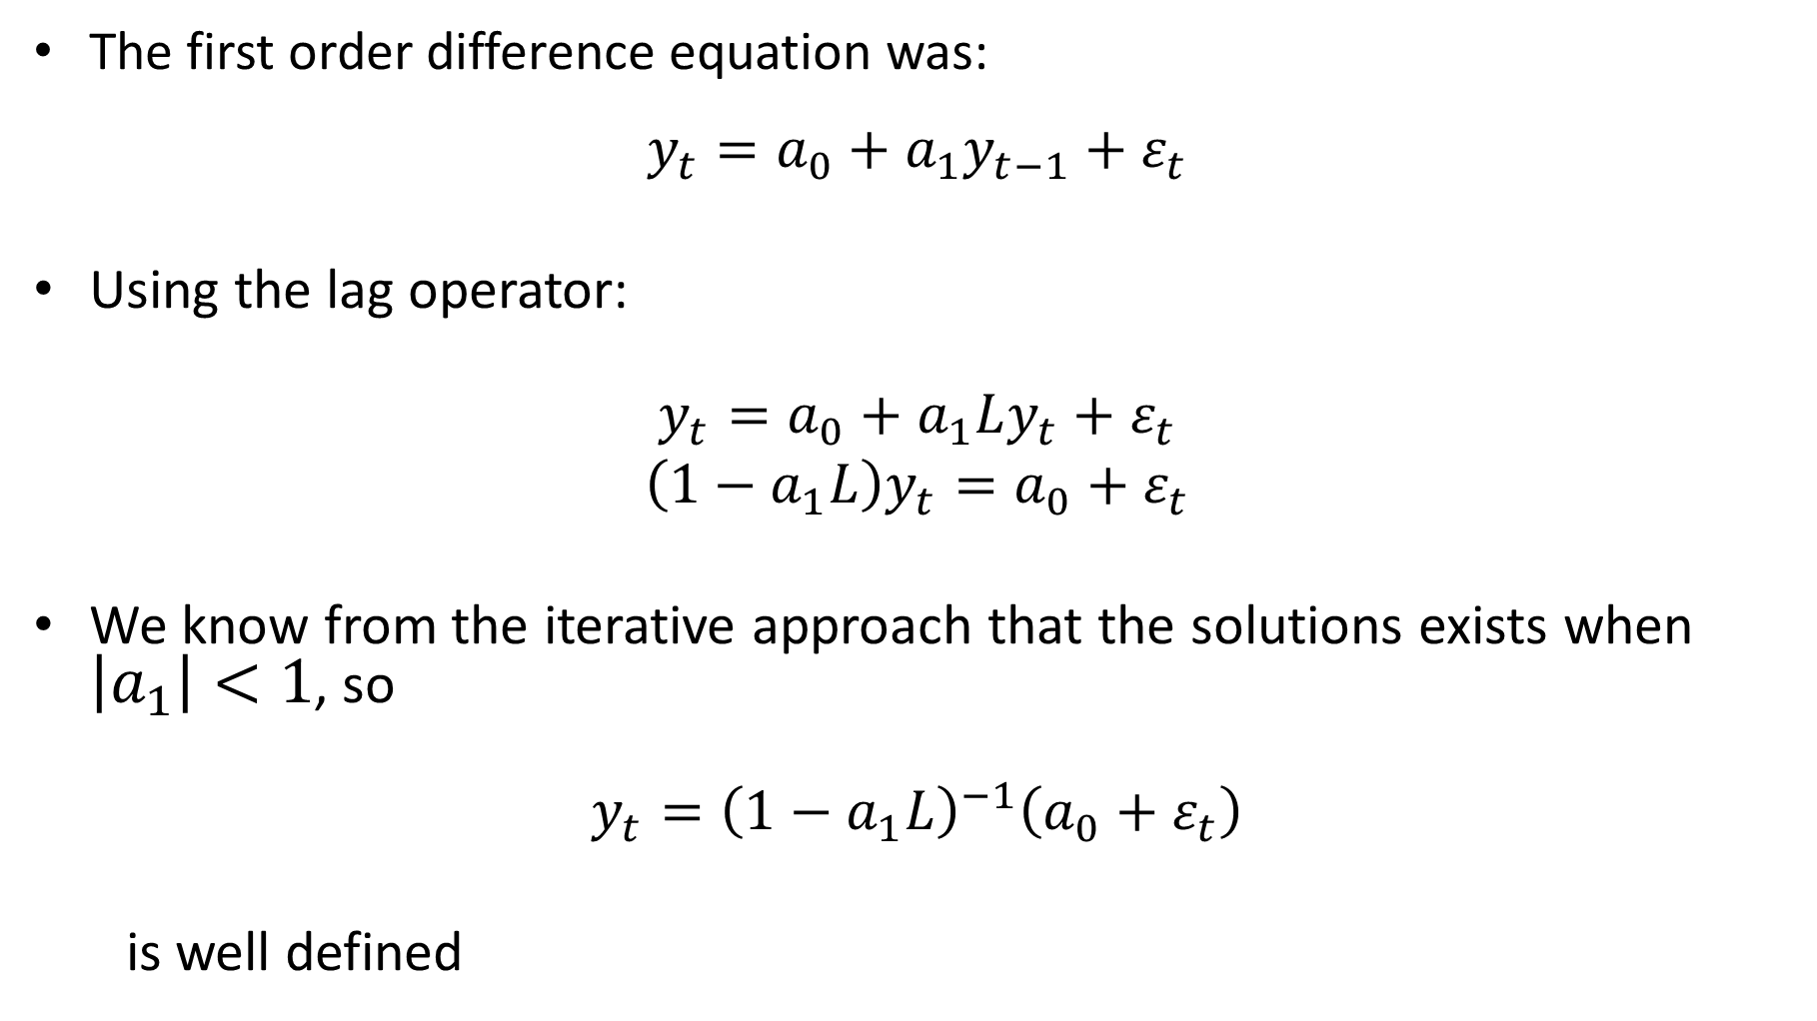
The solution of a 1st order Linear Difference Equation
The first order difference equation was:
$$y_{t}=a_{0}+a_{1}y_{t−1}+ε_{t}$$
Using the lag operator:
$$y_{t}=a_{0}+a_{1}Ly_{t}+ε_{t}$$
$$\left(1−a_{1}L\right)y_{t}=a_{0}+ε_{t}$$
We know from the iterative approach that the solutions exists when $\left|a_{1}\right|<1$, so
$$y_{t}={\left(1−a_{1}L\right)}^{−1}\left(a_{0}+ε_{t}\right)$$
is well defined

Slide 95

The solution of a 1st order Linear Difference Equation
The first order difference equation was:
$$y_{t}=a_{0}+a_{1}y_{t−1}+ε_{t}$$
Using backwards iteration without an initial condition but with the constraint that $\left|a_{1}\right|<1$ we showed that a solution was:
$$y_{t}=\frac{a_{0}}{1−a_{1}}+\sum_{i=0}^{∞}{a_{1}^{i}ε_{t−i}}$$

Slide 96
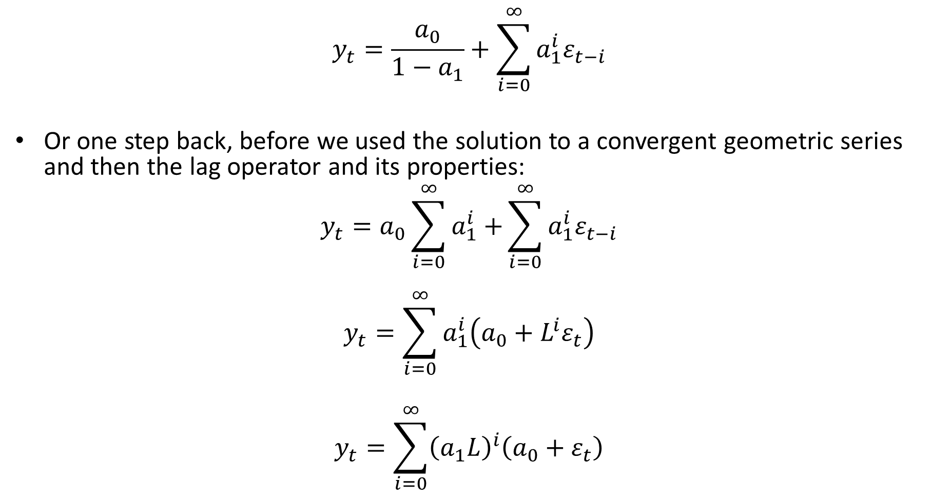
The solution of a 1st order Linear Difference Equation
$$y_{t}=\frac{a_{0}}{1−a_{1}}+\sum_{i=0}^{∞}{a_{1}^{i}ε_{t−i}}$$
Or one step back, before we used the solution to a convergent geometric series and then the lag operator and its properties:
$$y_{t}=a_{0}\sum_{i=0}^{∞}{a_{1}^{i}+}\sum_{i=0}^{∞}{a_{1}^{i}ε_{t−i}}$$
$$y_{t}=\sum_{i=0}^{∞}{a_{1}^{i}\left({a_{0}+L^{i}ε}_{t}\right)}$$
$$y_{t}=\sum_{i=0}^{∞}{{\left(a_{1}L\right)}^{i}\left({a_{0}+ε}_{t}\right)}$$

Slide 97

The solution of a 1st order Linear Difference Equation
Thus the solution
$$y_{t}=\sum_{i=0}^{∞}{{\left(a_{1}L\right)}^{i}\left({a_{0}+ε}_{t}\right)}$$
Must be equivalent to
$$y_{t}={\left(1−a_{1}L\right)}^{−1}\left(a_{0}+ε_{t}\right)$$
Thus we conclude that
$${\left(1−a_{1}L\right)}^{−1}=\sum_{i=0}^{∞}{{\left(a_{1}L\right)}^{i}}<∞$$
if and only if $\left|a_{1}\right|<1$

Slide 98
The solution of a 1st order Linear Difference Equation
Thus the solution
$$y_{t}=\sum_{i=0}^{∞}{{\left(a_{1}L\right)}^{i}\left({a_{0}+ε}_{t}\right)}$$
Must be equivalent to
$$y_{t}={\left(1−a_{1}L\right)}^{−1}\left(a_{0}+ε_{t}\right)$$
Thus we conclude that
$${\left(1−a_{1}L\right)}^{−1}=\sum_{i=0}^{∞}{{\left(a_{1}L\right)}^{i}}<∞$$
if and only if $\left|a_{1}\right|<1$
Pay close attention to this result: When it exists, the inverse of a finite order polynomial in the lag operator is a convergent, infinite order lag polynomial

Slide 99

Recap:
Time series are often persistent
Can deviate from its expected value for extended periods. I.e. current values are correlated with past values
To model this dependence, we propose a linear difference equation as the data generating process
$$y_{t}=a_{0}+a_{1}y_{t−1}+a_{2}y_{t−2}+…+a_{n}y_{t−n}+ε_{t}$$
The properties of the estimators of the coefficients depends on whether the process is stationarity
A stationary process is represented by a difference equation that is stable
I.e. has a well-defined solution
Using lag operators, we can define the inverse characteristic equation of the process
$$\left(1−a_{1}L−a_{2}L^{2}−…−a_{n}L^{n}\right)y_{t}=a_{0}+ε_{t}$$
A difference equation is stable if: the absolute value of the roots of its inverse characteristic equation are all $≥1$
$$\left|roots\left(1−a_{1}L−…−a_{n}L^{n}\right)\right|>1$$
Finding roots of polynomials is easy numerically

Slide 100

The solution of a 1st order Linear Difference Equation
$\left(1−a_{1}L\right)$ is the inverse characteristic polynomial of the first order difference equation $y_{t}=a_{0}+a_{1}y_{t−1}+ε_{t}$
The roots of a polynomial in a real/complex variable $L$ are the set of values of $L^{∗}$ that sets the polynomial equal to zero.
In this case the $L^{∗}$ that solves:
$$\left(1−a_{1}L^{∗}\right)=0 \\ L^{∗}=\frac{1}{a_{1}}$$
Since we know that this inverse of this lag polynomial exists when $\left|a_{1}\right|<1$, that implies that $\left|L^{∗}\right|>1$
In words: a difference equation has a solution (backwards, into the past) if and only if all the roots of its inverse characteristic equation are all larger than 1 in absolute value

Slide 101

The solution of a 2nd order Linear Difference Equation
Consider the second order difference equation
$$y_{t}=a_{0}+a_{1}y_{t−1}+a_{2}y_{t−2}+ε_{t}$$
The inverse characteristic polynomial is
$$\left(1−a_{1}L{−a}_{2}L^{2}\right)$$
Can you find its roots?
If not, can you factor the polynomial?

Slide 102

Yes, you can:
Consider the basic quadratic equation:
$$ax^{2}+bx+c=0$$
The solutions to this equation, $x_{1}^{∗}$ and $x_{2}^{∗}$, are given by the quadratic equation solution from high school:
$$x_{1}^{∗}=\frac{−b+\sqrt{b^{2}−4ac}}{2a}$$
$$x_{2}^{∗}=\frac{−b−\sqrt{b^{2}−4ac}}{2a}$$
So, we can factor the polynomial:
$$ax^{2}+bx+c=a(x−x_{1}^{∗})(x−x_{2}^{∗})$$

Slide 103

Let the factors of $\left(1−a_{1}L{−a}_{2}L^{2}\right)$ be: $\left(1−α_{1}L\right)\left(1−α_{2}L\right)$ then we obtain:
$${\left(1−α_{1}L\right)\left(1−α_{2}L\right) y}_{t}=a_{0}+ε_{t}$$
Now we have effectively converted a second order process into two possibly distinct first order processes:
Define $x_{t}=\left(1−α_{2}L\right)y_{t}$, so:
$$\left(1−α_{1}L\right)x_{t}=a_{0}+ε_{t}$$
For this process to be stable/have a solution we need $\left|α_{1}\right|<1$ or that $\left|root\left(1−α_{1}L\right)\right|>1$
Define $z_{t}=\left(1−α_{1}L\right)y_{t}$, so:
$$\left(1−α_{2}L\right)z_{t}=a_{0}+ε_{t}$$
For this process to be stable/have a solution we need $\left|α_{2}\right|<1$ or that $\left|root\left(1−α_{2}L\right)\right|>1$
So, for the original process to be stable/have a solution, both roots of the inverse characteristic polynomial must be larger than 1 in absolute value, or equivalently outside the unit circle

Slide 104
Important terminology
The following statements are equivalent:
The roots of the inverse characteristic polynomial are larger than 1 in absolute value
The roots of the inverse characteristic polynomial are outside the unit circle
What is this unit circle business?

Slide 105

Real and Complex numbers
In high school math, one typically only works with real numbers
More advanced math also requires the use of complex numbers
Complex numbers contain the imaginary number $\sqrt{−1}$
A complex number $z$ is typically written as:
$$z=α+β\sqrt{−1}$$

Slide 106

Real and Complex numbers
Consider the basic quadratic equation:
$$ax^{2}+bx+c=0$$
The solutions to this equation, $x_{1}^{∗}$ and $x_{2}^{∗}$, are given by the quadratic equation:
$$x_{1}^{∗}=\frac{−b+\sqrt{b^{2}−4ac}}{2a}$$
$$x_{2}^{∗}=\frac{−b−\sqrt{b^{2}−4ac}}{2a}$$

Slide 107

Real and Complex numbers
$$x_{i}^{∗}=\frac{−b±\sqrt{b^{2}−4ac}}{2a}$$
If $b^{2}−4ac>0$
$x_{1}^{∗}$ and $x_{2}^{∗}$ are real numbers, and distinct $x_{1}^{∗}≠x_{2}^{∗}$
If $b^{2}−4ac=0$
$x_{1}^{∗}$ and $x_{2}^{∗}$ are real numbers, and identical $x_{1}^{∗}=x_{2}^{∗}$
If $b^{2}−4ac<0$
$x_{1}^{∗}$ and $x_{2}^{∗}$ are complex numbers, and in come in a distinct pair of complex conjugate numbers:
$$x_{1}^{∗}=α+β\sqrt{−1}$$
$$x_{2}^{∗}=α−β\sqrt{−1}$$

Slide 108






Real and Complex numbers
We can represent a pair of complex conjugates,
$$x_{1}^{∗}=α+β\sqrt{−1}$$
$$x_{2}^{∗}=α−β\sqrt{−1}$$
graphically on the complex plane
Axis of imaginary numbers
$$x_{1}^{∗}$$
$$β$$
$$α$$
Axis of real numbers
$$−β$$
$$x_{2}^{∗}$$

Slide 109



Real and Complex numbers
The absolute values of a pair of complex numbers is given by
$$\left|x_{1}^{∗}\right|=\sqrt{α^{2}+β^{2}}=r$$
$$\left|x_{2}^{∗}\right|=\sqrt{α^{2}+{\left(−β\right)}^{2}}=r$$
Thus, the absolute values of a pair of complex conjugate numbers are always identical, and equal to the distance to the origin of the complex plane:
Axis of imaginary numbers
$$x_{1}^{∗}$$
$$β$$
$$r$$
$$α$$
Axis of real numbers
$$r$$
$$−β$$
$$x_{2}^{∗}$$

Slide 110


Real and Complex numbers
If the absolute value of a pair of complex conjugate numbers is larger than 1:
$$\left|x_{1}^{∗}\right|=\sqrt{α^{2}+β^{2}}=r>1$$
$$\left|x_{2}^{∗}\right|=\sqrt{α^{2}+{\left(−β\right)}^{2}}=r>1$$
we say they are “outside the unit circle”:
Axis of imaginary numbers
$$x_{1}^{∗}$$
$$β$$
$$1$$
$$α$$
Axis of real numbers
$$−β$$
$$x_{2}^{∗}$$

Slide 111


2nd order Linear Difference Equation Behaviour
In the 1st order difference equation, we could determine its behaviour by looking only at $a_{1}$.
It is feasible to do the same for the 2nd order difference equation in terms of $a_{1}$ and $a_{2}$, but it is not intuitive:

Slide 112

n^{th} order Linear Difference Equation
A typical n^{th} order Linear Difference Equation
$$y_{t}=a_{0}+a_{1}y_{t−1}+a_{2}y_{t−2}+…+a_{n}y_{t−n}+ε_{t}$$
Can be written as:
$$\left(1−a_{1}L−a_{2}L^{2}−…−a_{n}L^{n}\right)y_{t}=a_{0}+ε_{t}$$
Which can be factored as:
$$\left(1−α_{1}L\right)\left(1−α_{2}L\right)…\left(1−α_{n}L\right)y_{t}=a_{0}+ε_{t}$$
I.e. it can be considered as n distinct 1st order difference equations, each of which must be stable for the nth order difference equation to be stable, hence the rule: all roots of the inverse characteristic polynomial must be outside the unit circle. This will extend directly to Vector Auto Regressions.
Notes:
Up to this point, we have used standard arguments

Slide 113

Characteristic Polynomial and its inverse:
A typical n^{th} order Linear Difference Equation
$$y_{t}=a_{0}+a_{1}y_{t−1}+a_{2}y_{t−2}+…+a_{n}y_{t−n}+ε_{t}$$
It’s inverse characteristic polynomial:
$$\left(1−a_{1}L−a_{2}L^{2}−…−a_{n}L^{n}\right)$$
Define $z=L^{−1}$, multiply by $z^{n}=L^{−n}$
$$\left(z^{n}−a_{1}z^{n−1}−a_{2}z^{n−2}−…−a_{n}\right)$$
This is the characteristic polynomial.
If all the roots of the inverse characteristic polynomial are outside the unit circle, all the roots of the characteristic polynomial are inside the unit circle, then a difference equation is “backwards stable” in the sense that it has a backward solution without an initial condition

Slide 114
Important Cases
There are several patterns the roots of the inverse characteristic equation may fall in that give different dynamic behaviour:
Distinct Real Roots
All roots outside the unit circle
stable, mean reverting, Non-explosive
One or more root = 1, others outside the unit circle
Random Walk type behaviour
Non-mean reverting, Non-explosive
One or more root inside unit circle
Explosive – homogenous part eventually dominates
Repeated Roots
hump-shaped
Imaginary Roots
oscillating
(Naturally, if e.g. a statistics program is set up to evaluate the roots of the characteristic equation, the rule flips around – inside the unit circle is stable, outside explosive).

Slide 115
Summary
Our purpose was to derive the rule that tells us when a difference equation has a backward solution without an initial condition
That rule is:
The roots of the inverse characteristic polynomial must be outside the unit circle
Equivalently:
the absolute value of the roots must be larger than 1
This will become the universal test for stationarity in the rest of the course (and in all of time series econometrics)
Roots for any order polynomial can be trivially computed by any computational program
Hence we have the fundamental rule that distinguishes different time series models – non-stationary vs stationary models.

Slide 116
For next session:
Review the work, read through the chapter and practice the examples
On Thursday we will do an introduction to Matlab and simulate some of these processes to get a hands-on feel for the meaning of the stationarity rule

Slide 117

Expected value of a stationary process
We will delve into this next week, but it will be useful for the tutorial to establish one more result
We’ve shown that, if $\left|a_{1}\right|<1$ we can represent the difference equation
$$y_{t}=a_{0}+a_{1}y_{t−1}+ε_{t}$$
as a constant plus a moving average of white noise errors
$$y_{t}=\frac{a_{0}}{1−a_{1}}+\sum_{i=0}^{∞}{a_{1}^{i}}ε_{t−i}$$
Taking unconditional expectations on both sides:
$$E\left(y_{t}\right)=\frac{a_{0}}{1−a_{1}}+\sum_{i=0}^{∞}{a_{1}^{i}}E\left(ε_{t−i}\right)=\frac{a_{0}}{1−a_{1}}$$
Since $ε_{t}$ is white noise, $E\left(ε_{t}\right)=0 for all t$

Slide 118

Expected value of a stationary process
This extends to nth order equations
Let $y_{t}$ follow the process:
$$y_{t}=a_{0}+a_{1}y_{t−1}+a_{2}y_{t−2}+…+a_{n}y_{t−n}+ε_{t}$$
If $y_{t}$ is stationary, then:
$$E\left(y_{t}\right)=\frac{a_{0}}{1−a_{1}−…−a_{n}}$$

